Slide 1
‘Autistic Spectrum Conditions: developing school-based strategies for supporting pupils to learn’
Alison Cater
Ann Dix
Helen Mills

Slide 2
Welcome and housekeeping
Fire safety
Toilet facilities
Refreshments
Mobile phones to silent

Slide 3
Getting started
Hopes and expectations
Why focus on these topics

Slide 4
An overview
What are we talking about and why?
What is the impact in schools?
Break
What can we do in schools?
Action planning
Evaluation

Slide 5
Groundrules
How do we want to feel during this training?
What will we do to ensure we feel like this?

Slide 6
What are we talking about?
Autism spectrum disorder (ASD) is the name for a range of similar conditions, including Asperger syndrome, that affect a person's social interaction, communication, interests and behaviour.
In children with ASD, the symptoms are present before three years of age, although a diagnosis can sometimes be made after the age of three.
It's estimated that about 1 in every 100 people in the UK has ASD. More boys are diagnosed with the condition than girls
Notes:
All from NHS Choices

Slide 7
Autism is a lifelong developmental disability that affects how people perceive the world and interact with others.
Autistic people see, hear and feel the world differently to other people. If you are autistic, you are autistic for life; autism is not an illness or disease and cannot be 'cured'. Often people feel being autistic is a fundamental aspect of their identity.
Notes:
From the NAS

Slide 8
Prevalence
There are around 700,000 people in the UK living with autism - that's more than 1 in 100. People from all nationalities and cultural, religious and social backgrounds can be autistic, although it appears to affect more men than women.

Slide 9
Causes of Autism
Genes
Environmental triggers
Other health conditions
Misconceptions about the causes of Autism
Notes:
No one gene is responsible but there is evidence of Autism in families
Some researchers believe that a person born with a genetic vulnerability to ASD only develops the condition if they're exposed to a specific environmental trigger.
Possible triggers include being born prematurely (before 35 weeks of pregnancy), or being exposed in the womb to alcohol or to certain medication, such as sodium valproate (sometimes used to treat epilepsy during pregnancy).
No conclusive evidence has been found linking pollution or maternal infections in pregnancy with an increased risk of ASD
Below are some other conditions known to be associated with ASD:
muscular dystrophy – a group of inherited genetic conditions that gradually cause the muscles to weaken
Down's syndrome – a genetic condition that typically causes a learning disability and a range of physical features
cerebral palsy – conditions that affect the brain and nervous system, causing problems with movement and co-ordination
infantile spasms – a type of epilepsy that develops while a child is still very young (usually before they're one year old)
neurofibromatosis – a number of genetic conditions that cause tumours to grow along the nerves (the main types areneurofibromatosis type 1 and neurofibromatosis type 2)
the rare genetic conditions fragile X syndrome, tuberous sclerosis and Rett syndrome
the MMR vaccine
thiomersal – a compound that contains mercury, which is used as a preservative in some vaccines
the way a person has been brought up
diet, such as eating gluten or dairy product

Slide 10
In brief
Notes:
https://youtu.be/d4G0HTIUBlI

Slide 11
Some of the main signs that a child may be on the autism spectrum
not drawing their parents’ or others’ attention to objects or events, for example pointing at a toy or a book, or at something that is happening nearby (or a child may eventually do this, but later than expected)
carrying out activities in a repetitive way, for example always playing the same game in the same way, or repeatedly lining toys up in a particular order
resistance to change or doing things differently
emerging difficulties with social interaction and social communication
behaviour such as biting, pinching, kicking, pica (putting inedible items in the mouth), or self-injurious behaviour.
Notes:
http://www.autism.org.uk/about/diagnosis/children.aspx

Slide 12
Diagnosis
Usually done by a multi-disciplinary team
In Leeds CAMHS conduct specialist assessments for Autistic Spectrum Conditions (ASC)
Notes:
The child or young person who is referred for an autism assessment will normally be seen by a team consisting of two or more professionals. Often this team has a paediatrician or a psychiatrist, a psychologist and/or a speech and language therapist.
These professionals will take a detailed developmental history. They will meet the child or young person to assess their social communication skills and other strengths or weaknesses such as their learning or language abilities.
They can recommend help such as extra support at school, treatment for other mental health problems or parenting advice. There is no cure for autism, but with help, the individual and their carers can learn to cope better.

Slide 13
Assessment will include
detailed questions about parent's or carer's concerns and, if appropriate, the child's or young person's concerns
details of the child's or young person's experiences of home life, education and social care
a developmental history, focusing on developmental and behavioural features consistent with ICD-10 or DSM-IV criteria (consider using an autism-specific tool to gather this information)
assessment (through interaction with and observation of the child or young person) of social and communication skills and behaviours, focusing on features consistent with ICD-10 or DSM-IV criteria (consider using an autism-specific tool to gather this information)
Notes:
NICE guidance

Slide 14
a medical history, including prenatal, perinatal and family history, and past and current health conditions
a physical examination
consideration of the differential diagnosis (see recommendation 1.5.7)
systematic assessment for conditions that may coexist with autism (see recommendation 1.5.15)
development of a profile of the child's or young person's strengths, skills, impairments and needs that can be used to create a needs-based management plan, taking into account family and educational context.
communication of assessment findings to the parent or carer and, if appropriate, the child or young person.

Slide 15
Uncertainty
People with autism often find it difficult to handle uncertainty about what is happening next, or what will happen in the future. If routine is broken or their 'need for sameness' is not met, they can become overwhelmingly anxious. On top of this, they often have limited understanding of the emotions they are feeling. They struggle with what they could do to make themselves feel better.
Notes:
This and following slides taken from MindEd e-learning course

Slide 16
Rituals
Rituals (such as the need to do the morning routine in a particular order), obsessions (like an intense interest in silky fabrics) and repetitive behaviour (for example, flicking light switches on and off) create problems when they intrude on family life, or other aspects of their lives.
These behaviours can also isolate the individual from interaction with other people; they restrict opportunities for developing appropriate skills

Slide 17
Imagination
Some, but not all, individuals with autism have difficulties with imagination. This may be seen in:
Lack of pretend play in younger children
Difficulties writing stories and essays at school
Problems anticipating what might happen in the future
Predicting the consequences of actions
Recognising danger
Problems in thinking about how others may be thinking or feeling

Slide 18
The voices of people with a diagnosis
Notes:
Young adults talking about being on the Autistic Spectrum from BBC 3 there is some swearing so check with people before showing

Slide 19
Parents’ views
Notes:
From Healthwatch Derbyshire 2015 who spoke to 26 families

Slide 20
Break
an elephant in the room

Slide 21
Interventions
Psychosocial interventions
Specific social-communication intervention for the core features of autism in children and young people; play-based strategies with parents, carers and teachers to increase joint attention, engagement and reciprocal communication in the child or young person. Strategies should:
be adjusted to the child or young person's developmental level
aim to increase the parents', carers', teachers' or peers' understanding of, and sensitivity and responsiveness to, the child or young person's patterns of communication and interaction
Notes:
From NICE CG 170
There is also guidance on interventions to prevent and manage challenging behaviour, sleep, co-existing conditions and to develop life skills

Slide 22
include techniques of therapist modelling and video-interaction feedback
include techniques to expand the child or young person's communication, interactive play and social routines. The intervention should be delivered by a trained professional. For pre‑school children consider parent, carer or teacher mediation. For school‑aged children consider peer mediation

Slide 23
Classroom strategies
Visual aids
Comic Strip Conversations
Social stories
Social skills
Circle of friends
The Picture Communication Exchange System (PECS)
TEACCH
Behaviour
Notes:
These are from NAS website
Visual aids
Many children with autism find it easier to understand the world about them through visual aids. Teachers may use a visual timetable showing times and simple drawings of the activities, so that the pupil knows exactly what they will be doing and when. Many schools use computer software packages to write out stories, descriptions and instructions in both words and symbols simultaneously. Other visual supports include written lists, objects and calendars to help children understand sequence and predict what is happening.
Comic Strip Conversations
Comic Strip Conversations assist children with autism to develop greater social understanding, by providing visual representations of the different levels of communication that take place in a conversation, using symbols, stick figure drawings and colour. By seeing the different elements of a conversation visually presented, some of the abstract aspects of social communication (eg recognising the feelings and intentions of others) are made more concrete and are therefore easier for the child to understand.
Social StoriesTM
Children with autism who can read may be taught how to cope with different situations using the technique of Social StoriesTM. Stories are written for the individual child, explaining in words and pictures, step by step, what will happen in situations where they may feel anxious and how they should cope with situations they find difficult. For instance, a Social StoryTM might be used to explain what a child should do on a bus journey or when they hear a fire alarm.
Social skills
Some children with autism respond well to drama and role play activities to help them learn social skills such as greetings, turn taking in conversation and watching for cues in social skills groups. A Circle of Friends or buddy system can also help a child with autism understand the social world of the classroom and the playground.
Circle of Friends
Circle of Friends encourages the development of a support network for a child in a structured setting, which can also extend to outside of this setting. It is not an approach to provide instant friendship, but over the course of meetings and evaluation of set targets, it is hoped that the child will be able to build closer and better relationships with other children. Six to eight children are recruited as volunteers to form the Circle of Friends. Through a series of meeting they help the focus child to express his or her feelings and decrease anxiety levels. This can lead to improved social integration and higher levels of peer contact.
The Picture Communication Exchange System (PECS)
PECS is a commonly used approach to teach children who have limited language. Teachers use pictures as symbols to teach children the names of different objects. Gradually the child is taught to exchange a picture for the object he or she wants, to construct simple sentences using the pictures, and indicate choices between various objects.
TEACCH (Treatment and Education of Autistic and related Communication handicapped Children)
This approach is widely used within special schools and can be adapted for use within a mainstream setting. It focuses on altering the environment and using visual supports, such as timetable and schedules, to help provide structure, reduce stress and improve understanding. Children are given clear instructions for every stage of an activity, usually presented in a visual way.
The behaviour of some children with autism can be very difficult to deal with. It may not always be immediately obvious why the child is behaving in a particular way, and it can be hard to control the situation without knowing more about what lies behind it and what kinds of strategies to use. With limited verbal communication, a child with autism may, for example, not be able to express their feelings of anxiety, discomfort, or frustration except in an outburst of unwanted behaviour. They may have learnt from experience that such behaviour generally achieved their desired object. Therefore the teacher needs to analyse what had been going on before the outburst that might have upset the child, and teach them some other way of communicating what they want.

Slide 24
SPELL
developed by The National Autistic Society's schools and services to understand and respond to the needs of children and adults with autism.
Structure makes the world a more predictable, accessible and safer place and can aid personal autonomy and independence.
Positive approaches and expectations seek to establish and reinforce self-confidence and self-esteem by building on natural strengths, interest and abilities.
Empathy is essential to underpin any approach designed to develop communication and reduce anxiety.
The approaches and environment need to be low arousal: calm and ordered in such a way as to reduce anxiety and aid concentration.
Strong links between the various components of the person's life or therapeutic programme will promote and sustain essential consistency.

Slide 25
Notes:
https://youtu.be/K7JbMEyPxHs Nice simple video from Autism Scotland

Slide 26
1. Starting Point - Reduce Anxiety and Increase Familiarity
Choose the right person to work with the child e.g. calm, confident, trained and a genuine want to work with the child
Prior to meeting the child, show them a photo of the person who will be working with them and the activity they will be doing e.g. PECS
Get to know the child before you start teaching them
Find out what they like and talk about it
Find out what they don’t like and avoid it
Meet the child in their safe place (don’t expect too much early on)
Pop in to say hello - build trust and conversation
Start the intervention.

Slide 27
2. The Environment
Promote a calm and safe place e.g. calm music, low lighting, low stimulus displays e.g. not too busy or bright
Promote familiarity e.g. objects that the child likes
Prepare the child for changes to their normal routine e.g. when visiting new places and changing their timetable use pictures and PECS beforehand.

Slide 28
3. Structure of the Session
Introduce structure e.g. use PECS, same day and time, start and end activities the same
Rules and boundaries
Introduce new activities gradually
Allow choice (two options)
Use positive praise and rewards
Be accepting of when things don’t go to plan, if a child has a ‘melt down’, helping them to feel safe and calm is key rather than the aim of the session.

Slide 29
4. Monitor Progress and Set Backs
Track the child’s progress each session
Be patient – some children need to observe for a few sessions, some only participate for a few minutes, yet trust me, they are learning!
Managing behaviour - Become aware of and note child’s:
1. Triggers that cause a child to have a ‘melt down’ or behave inappropriately (this make take some time) – Share whole school
2. Likes and dislikes (these may change) - Share whole school
Positive praise
Reward for good behaviour, effort and progress e.g. dinosaur stickers on reward chart and rewards that the child likes.

Slide 31
Case Study 1
Landgate Autistic School
ASD Girl
Issue
Strategies implemented
Progress made.
Notes:
Landgate Autistic School - ASD girl at a big event, anxious, making noises, rocking, hitting support worker, brought in her yoga mat to sit on (familiarity & association with calmness), behaviour changed, calm, stroking support worker, attention).

Slide 32
Case Study 2
Corpus Christi Primary School
Small group intervention (2 ASD boys, 1 ADHD boy)
https://m.youtube.com/playlist?list=PLDKGHjG_MJg7u1b26CM3DpWN6UGWzbCRD
Issue
Strategies implemented
Progress made.
Notes:
Story of Boy on film.

Slide 33
Case Study 3
St Theresa’s Catholic Primary School
Y3 Boy
Y3 Girl (name song)
Issue
Strategies implemented
Progress made.
Notes:
Story of Boy Y3. Story of Girl Y3 name song example.

Slide 34
Becoming Visible: identifying girls on the autistic spectrum

Slide 35
Diagnosing ASD
The ration of males to females in NAS schools is approx 5:1 and 4:1 in adult services.
Wing (1981) found there were 15 times more males, although this fell to 2:1 when learning disabilities were included.
Many women who are eventually diagnosed as ASD were initially diagnosed with learning difficulties, personality disorder, OCD and eating disorders. (Reynolds 2013)

Slide 36
Male and female brain development
Research suggests there is a difference in how male and female brain develops. (Baron Cohen 2003)
In pregnancy, foetal testosterone surges between 8-24 weeks , which increases the growth of right hemisphere which deals with logic, systemising, patterning and structures.
Lower levels of fT , typically found in girls lead to better communication skills, eye contact and use of language.
Baron Cohen’s ‘Extreme Male brain’ theory suggests the male brain is predominately hardwired for understanding and building systems. It may take fewer changes in boys brains to push them into autism.

Slide 37
Triad of impairment
Wing’s triad of impairment includes lack of eye contact, dislike of being touched, lack of social interaction and empathy , rigid and repetitive behaviours
These are more prevalent in boys than girls, who may learn social interaction and copy skills such as turn taking, smiling, eye contact etc
Girls go undetected because they have a non male- typical- presentation and an ability to camouflage their difficulties
Girls may be more motivated to conform socially and “pretend to be normal” (Attwood 2006)

Slide 38
How do girls differ in ASD presentation?
Girls may be looked after by other girls in school, so will not appear isolated. They may also play with younger children
Girls may be very creative, but have difficulty with flexible thinking and prefer rigid routines.
Girls may have intense interests in animals, pop stars etc, which may appear like neuro-typical girls
Girls may appear to use imaginative play, but this may be repetitive and intense
Girls may have vivid imaginary worlds, write stories, draw and read fiction as a relief from social interaction
Girls tend not to be disruptive in class, preferring to withdraw into their own imaginary worlds

Slide 39
Puberty and beyond
At puberty, girls lose the protective world of primary school and may struggle to fit in to the more tribal behaviour of teenage girls.
Social interaction amongst teenagers becomes more important and ASD girls may become more aggressive and confrontational as they try to cope.
Sex and relationships may cause difficulties and girls can be vulnerable to inappropriate relationships and grooming
Social media can be helpful in allowing girls to communicate with others, but can also make them vulnerable as they are unable to differentiate between genuine friendship and inappropriate behaviours
Some girls with ASD suggest that they may feel other’s emotions too intensely to cope, and may withdraw and self sooth.
Many women with high functioning ASD speak of intense feelings of fear and anxiety, and this leads to social exhaustion when they return home.

Slide 40
What can help girls with ASD?
Many people on the autistic spectrum prefer to think visually rather than verbally. Developing symbolic capacity encourages language development and reduction in stereotypical behaviours.
Small group-work
Structured games with rules
Drama and role play
Music and dance
Social stories
Creative play
Puppets

Slide 41
A demo of how Solution Focused Practice works

Slide 42
Solution focus in practice
A simple guide to SF working is available at http://www.solutionfocused.net/what-is-solution-focused-therapy/
The NSPCC has produced SF guidance ‘A toolkit for working with children and young people’ available at https://www.nspcc.org.uk/globalassets/documents/publications/solution-focused-practice-toolkit.pdf

Slide 43
Action planning
Pick an area to work on that you have some control over.
Be as specific as you can
Rate how things are in relation to this on a scale of 1-10 with 1 being low and 10 being high.
Work your way through the questions in pairs

Slide 44
Resources

Slide 45
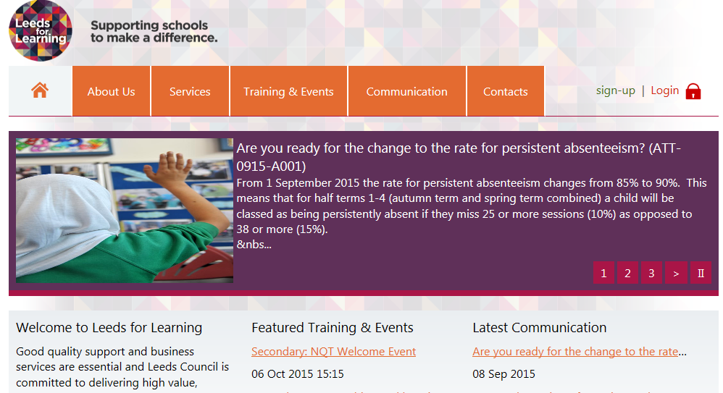
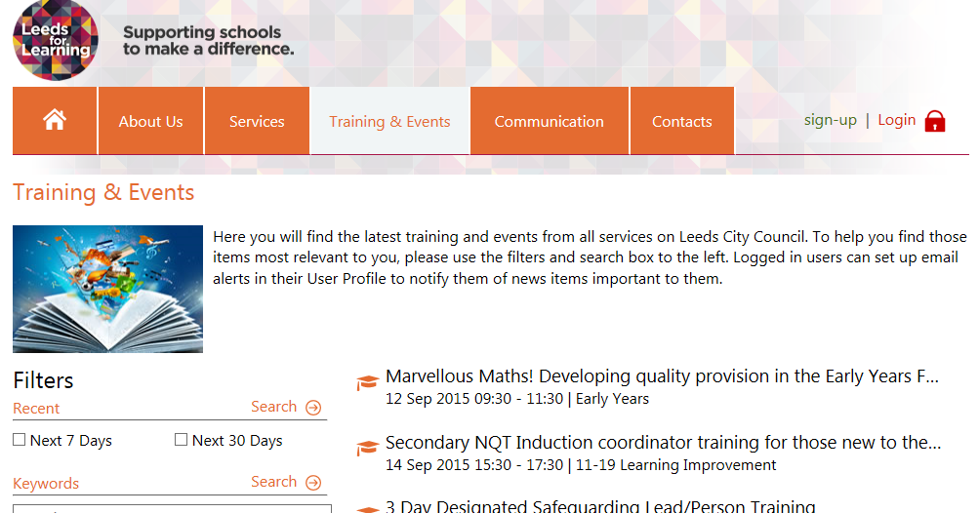
Booking further training or SLDM sessions?
Don’t forget to use www.leedsforlearning.co.uk

