Slide 1
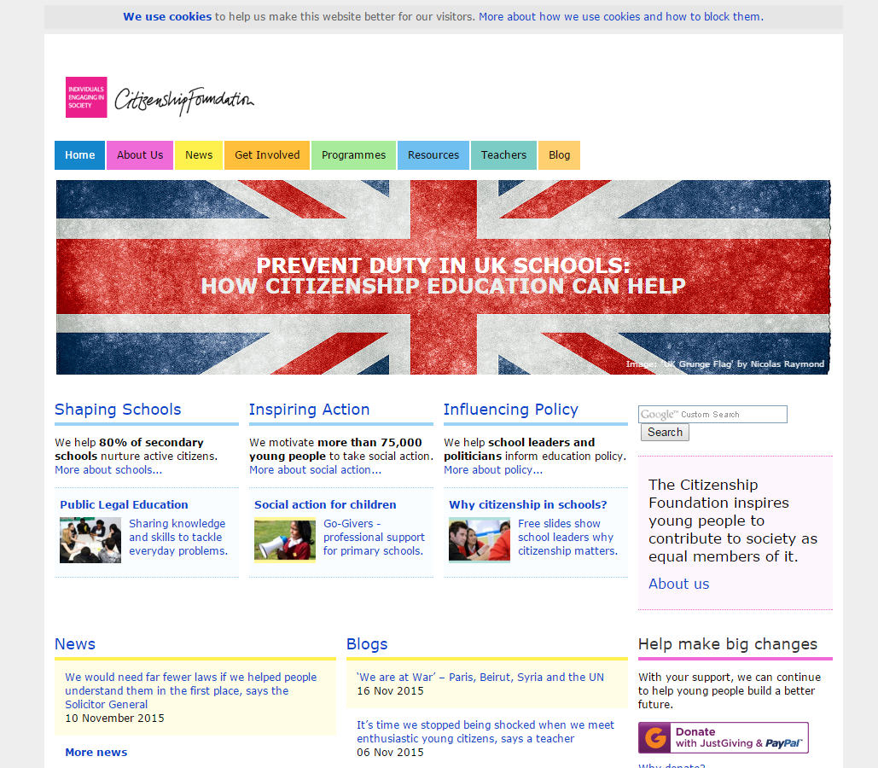

Slide 2
Website resources
Over 150 lessons
Interactive whiteboard tools
INSET Training
After-school staff meetings
Half-day/Full-day
Make a Difference Challenge
Active citizenship project for KS2
Jan - July

Slide 3
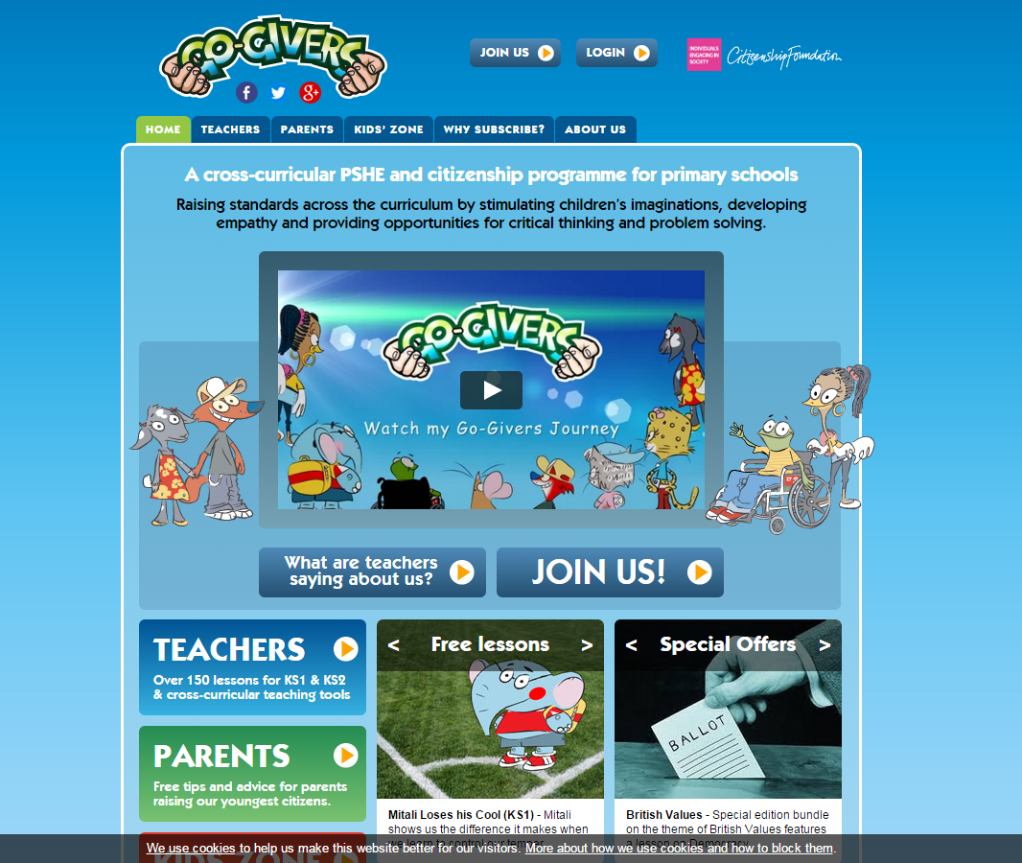

Slide 5
Teachers’ Training Day
Children choose a social or environmental problem as their project cause.
Children research causes and effects of the problem and find out more about the issue. Go-Givers suggest resources/organisations to help children with their research.
Children ‘Make a Difference’ to the problem by fundraising, raising awareness or taking direct action.
Representatives from each school make a persuasive presentation at Leeds Trinity University tell others how they can help.

Slide 6
‘The MADC challenge case studies highlight the value Go-Givers has in allowing the less academically able pupils to shine.’ Independent evaluation report by York Consulting

Slide 7
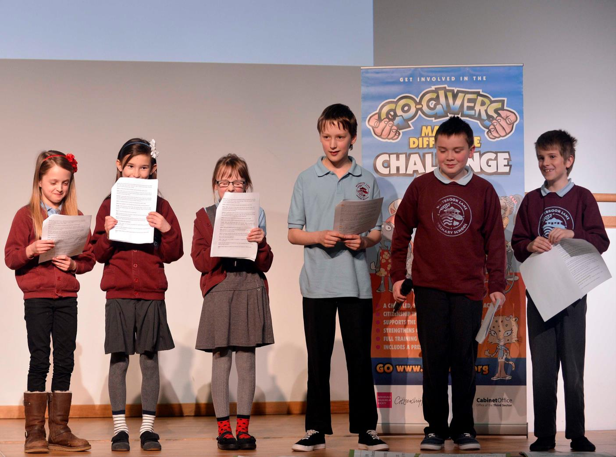

Slide 8
‘All schools report very positive experiences form the challenge, with wide-ranging benefits to child development (social, academic, emotional), the wider community, and school culture.’ Independent evaluation report by York Consulting

Slide 9
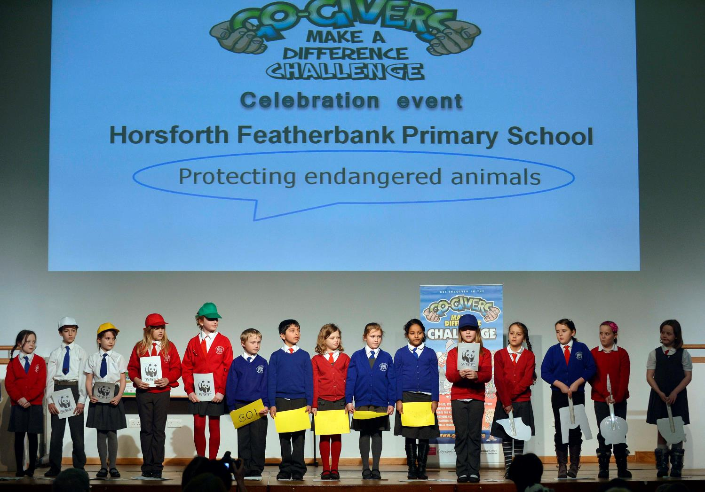

Slide 10
The project was ‘very effective in increasing empathy levels, problem-solving, grit, and community skills’ as in each of these areas there were ‘statistically significant differences between the pupils who participated in the project and the control group.’ From the results of a randomised control trial run by the Cabinet Office in Spring 2015 with participating schools in Kent and Birmingham

Slide 11
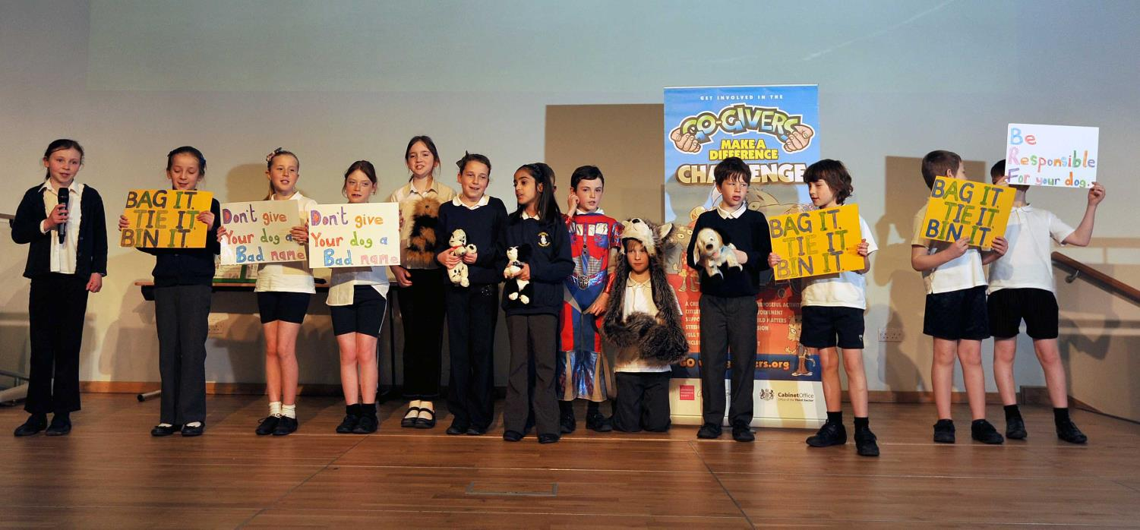

Slide 12
‘Almost all teachers (98%) would recommend the MADC to other schools, highlighting the unique qualities of the projects created, how it brings children and classes together, impact on pupil confidence and self-belief.’ Independent evaluation report by York Consulting

Slide 13
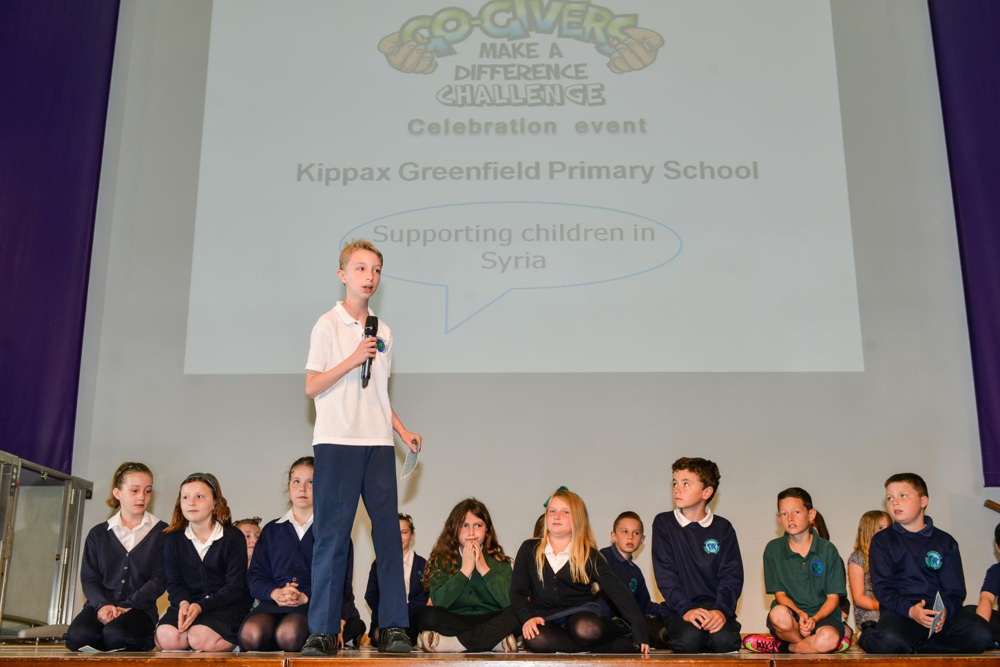

Slide 14
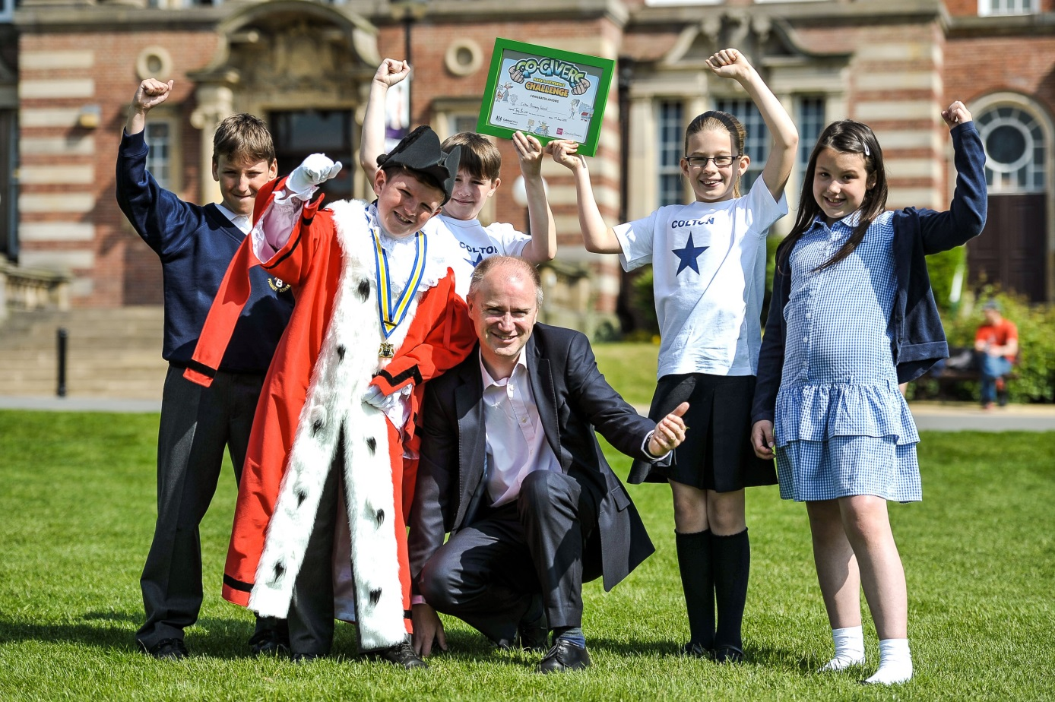
Yorkshire Evening Post 10th June 2014

