Slide 1
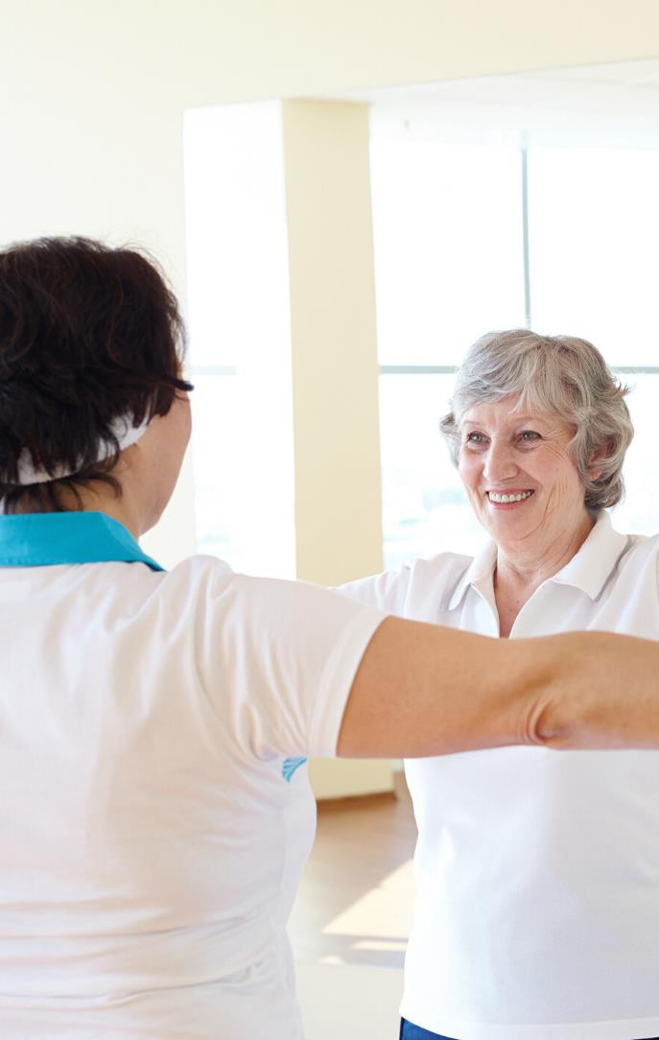
01

Slide 2
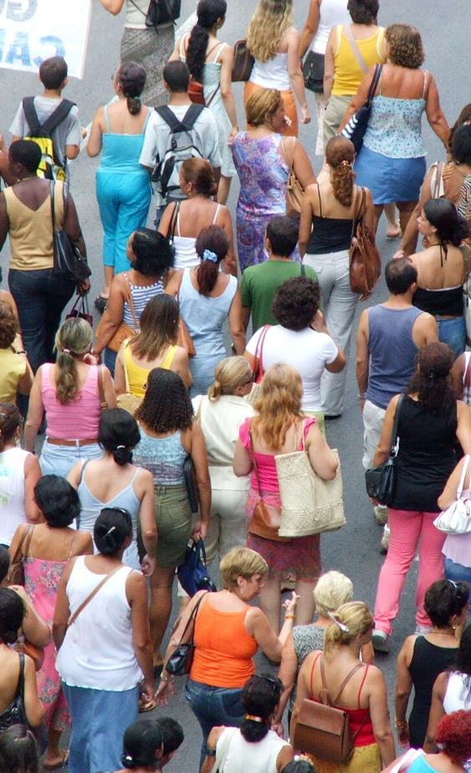
About us
One You Leeds is a free healthy living service funded by Leeds City Council. We are an easy to access option for residents to address a range of lifestyle issues.
A range of options are available, including support for self help, one to one healthy living interventions and group sessions.
Due to Covid-19 and government restrictions all our services are currently running remotely over the phone and through video link with resources being sent by postal distribution.
02

Slide 3
MAKING SMALL CHANGES CAn make a big difference
03

Slide 4
A great way of getting support to manage your weight in a friendly, group environment with no requirements to follow a set diet
28
One to one or group support for up to 12 weeks, including behaviour change and free nicotine replacement therapy
One to one or group support for up to 12 weeks with a coach, including behaviour change and free nicotine replacement therapy. All session are over the phone and nicotine replacement treatment is delivered by post
Health cooking classes delivered by Jamie Oliver’s Ministry of Food – only £8 per class or £2 if you meet eligibility criteria
Support to improve your eating habits with a coach – even if you’re not overweight
A range of cardio and strength based classes, available as live delivery (remote or face to face) or pre-recorded videos
Access to a private Facebook group. Join in on our Live sessions Mon-Wed or take part in them at your own convenience. You can access a range of strength and cardio sessions and resources are uploaded daily.
A 12 week course delivered in a group via video link or 6 1:1 sessions over 12 weeks delivered over the phone. A great way to lose weight, the course focuses on nutritional advice, alongside healthy eating tips and behaviour change support.
04

Slide 5
A great way of getting support to manage your weight in a friendly, group environment with no requirements to follow a set diet
28
One to one or group support for up to 12 weeks, including behaviour change and free nicotine replacement therapy
1:1 Support to improve your eating habits with a coach. 6 sessions delivered over the phone or by video link
Learn how to cook healthy meals on the 8 week cooking course delivered by Jamie Oliver’s Ministry of Food – only £8 per class or £2 if you meet eligibility criteria.
Currently being delivered by video link (these sessions are free)
Face to Face classes suspended from 5/11/2020 and will resume once government guidelines are lifted.
Support to improve your eating habits with a coach – even if you’re not overweight
A range of cardio and strength based classes, available as live delivery (remote or face to face) or pre-recorded videos
Not sure where to start. Your support offers 1:1 over the phone sessions with a health coach to help you on your way to become a healthier you.
05
Your Support

Slide 6
why is this important?
In the most recent statistics only 29% of adults and 18% of children ate 5+ portions of fruit and veg per day.
Related long-term conditions reduce life expectancy by an average of
9 years
The number of people with long-term conditions is increasing due to physical inactivity, poor diet and alcohol misuse
Obesity in the UK is rapidly rising - by 2050 it is predicted that 60% of men and 50% of women will be obese
06

Slide 7
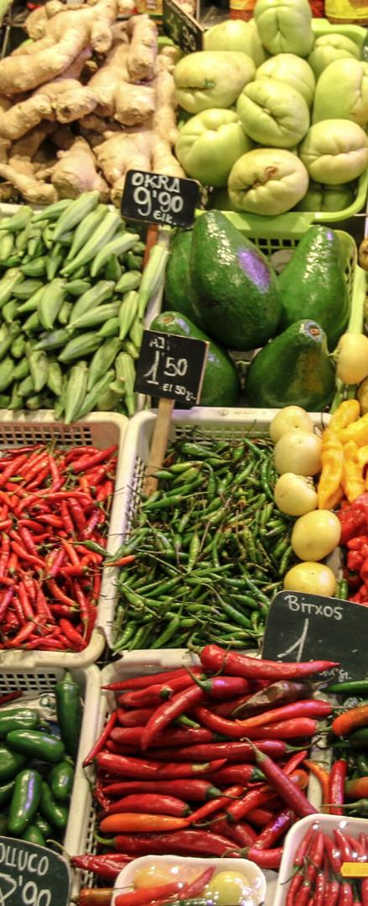
A Change for the better -SESSION objectives
07
A free one off health awareness session delivered over Zoom.
The remote session is 60 minutes and allows participants to recap on healthy living messages and ask questions.
To review healthy eating key messages, food labelling, physical activity guidelines alongside key healthy living messages.
To understand the support available to you.

Slide 8
08
During the session we will discuss
The changes to the Eatwell plate and current healthy eating guide.
How the EatWell guide translates to our every day plate
What benefits we get from eating a balanced diet
The rule of 300 for snacks

Slide 9
During the session we will discuss
Helpful hints for serving sizes
Consider our diets and discuss small changes that can be easily be made to support a healthier lifestyle
The importance about reading food labels
Tips and hints to make reading labels easier.
09

Slide 10
Each participant will be emailed a participant workbook full of useful resources to help them set a goal after the session.
10

Slide 11
11
People thought…
Carers Leeds - 5 out of 6 attendees were VERY SATISFIED with the event
They all reported learning something new.
2 made comments:
“I’m going to look at the website“
“Good pointer to other services that I wasn’t aware of. Very helpful, thank you!”
Touchstone - “During Lockdown we have ran the ‘One you Leeds Change for the Better session’ within two Mentally Healthy Leeds online groups, Time for You and BurMANtofts Skill and Social. It has been great to be able to talk about health and nutrition and the group attendees felt the session was useful, particularly as it was done within an interactive manner that allowed for group discussions. Belinda Saywell (MHL group facilitator) has reported that some group attendees have gone on to sign up to Be Smoke Free and Eat Better as a result of joining the session.”

Slide 12
0800 169 4219
oneyouleeds.co.uk
holly.birkinshaw@reedwellbeing.com
12

