Slide 1
Health & Wellbeing Service
PSHE Network Meeting
Weds 30th January 2019
www.schoolwellbeing.co.uk
www.healthyschools.org.uk
www.myhealthmyschoolsurvey.org.uk
Notes:
Good morning and welcome.
Introduce myself (Give role and history)
We have a wide variety of schools and staff today from Leeds (Primary, SILC, and College , Academy, Catholic, CofE,)
Fire Alarm Check, Toilets, Mobile Phones
Plan of the day – Look at the programme and times and the packs

Slide 2
Suzanne Macklin – Lead Practitioner (Young People’s Team)
Notes:
1.20pm – 1.40pm

Slide 3
Change 4 Life
Children in England are eating an extra 2,800 sugar cubes a year, which is more than double the recommended guidelines. That's 8 cubes too many each day!
How your school can get involved.
Sign up as a supporter at Public Health England so you can download posters and resources for your schools at https://campaignresources.phe.gov.uk/resources/campaigns/84-2019-change4life-nutrition-campaign/resources
Watch the video at https://www.nhs.uk/change4life
Create a display at your school
Deliver an assembly
Encourage all your parents/carers to sign up at https://www.nhs.uk/change4life e.g. in your school newsletters!
Watch out for the all the exciting resources that will be delivered directly to your school mid-January. There will be a pack for every pupil!
If your school is an academy the resources will not be delivered through the national programme. You can still pick up a resource pack for every pupil by contacting the Public Health Resource Centre
Notes:
Competition Handout

Slide 4
PREVENT Update - Jan 2019
Educate Against Hate - New Resources
Last term a number of new resources were uploaded to Educate Against Hate: (https://educateagainsthate.com/)
Green Spring PSHE sessions: Slide packs developed by Green Spring Academy. This package comprises 17 sessions with the suggestion that it is covered over 6 weeks with KS4 pupils. Each session could be delivered in around 15-30 mins. Few accompanying resources are needed, just a whiteboard or post-it notes.
Faith in Us – Educating about Islamophobia: Comprehensive guidance on educating young people on Islamophobia including myth busting, advice for school leaders and classroom resources. Chapters include: facilitating effective conversation and guidelines for dealing with Islamophobic incidents.
Shared Space Toolkit for Teachers of RE: The toolkit, designed in collaboration with teachers, researchers and the National Association for Teachers of RE (NATRE), presents tips, activity ideas and resource links to support contact theory in the RE classroom. The resource is split into advice to support (1) encountering, (2) interacting with, and (3) holding meaningful conversations with diverse groups.
Hate Crime Primary Lesson Plan: A presentation and lesson plan to teach upper primary about what a hate crime is and who can be a victim. While the organisation (Educate and Celebrate) has the mission to make all schools and workplaces LGBT+ friendly, this resource covers all the different protected characteristics.
Respectful School Communities: Self Review and Signposting Tool: A tool developed by the Department for Education to support schools develop a whole school approach that promotes respect and discipline. It also includes links to a range of other sources of support.
Featherstone Primary Curriculum Map: An exemplar curriculum map for fundamental British values in Primary provision, uploaded with permission from Featherstone primary school.
Since 9/11 Primary Resources: 10 lesson plans with accompanying resource packs produced by SINCE 9/11 in partnership with the UCL Institute of Education (IOE) to support primary schools to meet their duty to promote the Fundamental British Values of Democracy, the Rule of Law, Individual Liberty and Mutual Respect and Tolerance of Different Faiths and Beliefs in the curriculum.

Slide 5
PREVENT Update - Jan 2019
Free Workshops on Slavery for Years 5 & 6
Just Enough UK have 50 free workshops on Slavery for Primary Schools in Leeds.
‘Just Enough UK are an Educational organisation that delivers workshops on difficult global issues to primary school children all over the Country. We have educated over 70,000 children and 100% of teachers would recommend us to a colleague.
At Just Enough UK we do not shock or scare children but inspire them that one person can help to change the world. Our workshops fun and interactive using games, drama and role play to engage with the children.’
The workshops are delivered through Story Telling, Comedy and Multi Media and cover the history of slavery; How it was abolished in the UK by William Wilberforce; Why it did not go away; How people are tricked into Slavery today; The kind of jobs slaves are made to do; Characters in fiction who are slaves; How many slaves are in the world today; The five signs of slavery; How one person can make a change.
For further information or if you would like to book a workshop please email Bonney Baggaley at bonney@justenoughgroup.org or call 0300 999 1097.

Slide 6
Leeds Knife Crime Briefing
Pc Matt Guy
West Yorkshire Police
@PCMattGuy

Slide 7
Leeds Knife Crime Stats
Night-time Economy
Knife Crime offences mainly occurred early to late evening
Knife Crime was more prevalent on a weekend (Saturday and Sunday)
Males are more likely to be involved in Knife crime and Possession offences as both victims and offenders
All City Centre PWA’s have a high percentage of 20-29 year old victims and offenders on a weekend
Notes:
Assault with injury accounts for the most Knife crime offences and has seen a 14.9% increase compared to the previous 12 months. There has been a 12.5% decrease in Attempted Murder offences where a knife or sharp object is used.

Slide 8
Organised Criminal Groups
2,282 OCG members across the Force
349 links were established between OCG members and offences
offenders tended to be the younger end of OCG members of ethnic minority which is suggestive of young street gang violence
42 victims were identified as OCG members
Notes:
2,282 OCG members across the Force
When completing link analysis on the offenders and offences 349 links were established, suggesting one to many relationships, i.e. singular crimes to multiple offenders or singular offenders to multiple crimes which is indicative of gang mentality. When looking at the offences where multiple links were recorded the offenders tended to be the younger end of OCG members of ethnic minority which is suggestive of young street gang violence.
When comparing victims to the Organised Crime Group database, 42 victims were identified as OCG members. These 42 individuals were linked to 42 Knife crime offences, so no multiple victims or crimes, however there were 45 offenders linked to the 42 offences suggesting multiple offenders. Where a suspect was known, 14 of these offences were committed by other OCG members, it is highly believed that where an OCG member is a victim, the offender is likely to also be an OCG member.
Caution must be excised when comparing Knife crimes to OCG members as this is what we know, it is believed that many OCG members would not report such a crime and would look to seek their own retribution.

Slide 9
Gangs/Weapon Awareness Resources
Primary
Secondary
Gangs: Managing Risk Staying Safe
https://www.schoolwellbeing.co.uk/resources/536
#Knifefree
https://www.pshe-association.org.uk/curriculum-and-resources/resources/home-office-knifefree-lesson-plans-ks34?utm_source=PSHE%20Knifefree%20lesson%20plan%20promotion&utm_campaign=%23knifefree&utm_content=Knifefree%20lesson%20plans

Slide 10
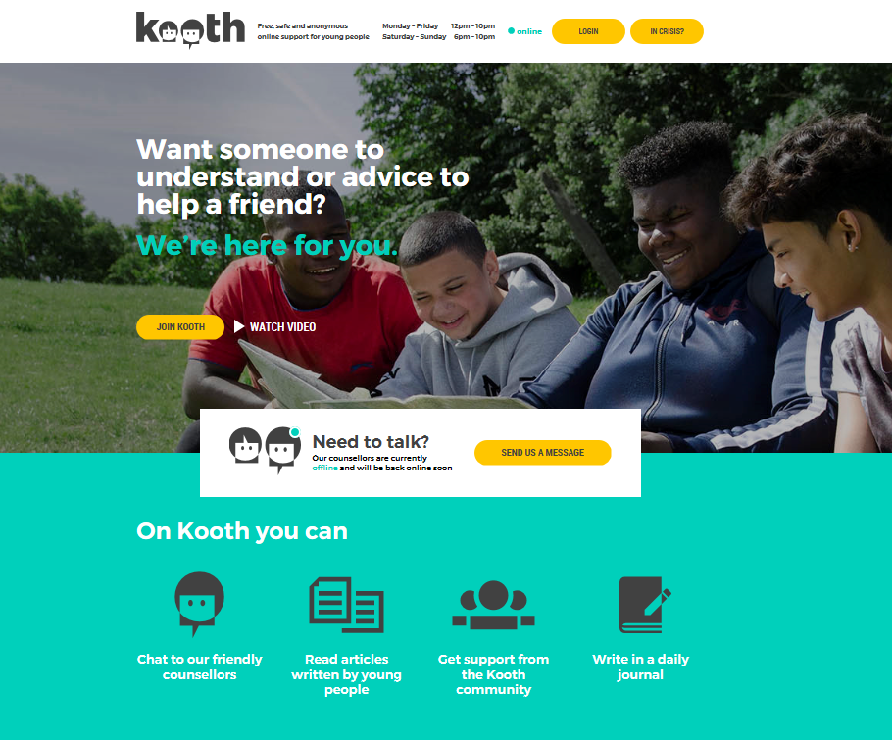
www.kooth.com
Sophie Carr - Kooth

Slide 12
What is your favourite App?
Discuss your favourite Apps?
Are there any that are important to your social life?
Do you use Apps at work?
What devices do you use them on?

Slide 13
Name The App?
1
2
3
4
5
6
7
8
9
10
Notes:
Activity – run through answers – share info with delegates on a handout

Slide 14
Apps Explained
Instagram is a picture and video sharing app. Users can post content and use hashtags to share experiences, thoughts or memories with an online community. Instagram allows live streaming.
Fortnite
In Fortnite, players collaborate to survive in an open-world environment, by battling other characters who are controlled either by the game itself, or by other players.
PopJam is a creative website for children and young people. You can share drawings, photos and audio messages with friends and other people.
MeetMe is a social network and dating site which allows users to meet and communicate with other people worldwide.
ROBLOX
Roblox is a multiplayer gaming platform. All games and experiences are created by the players themselves. It is a social platform too and players can interact with one another through the games and via the chat function.
Notes:
FORTNITE (additional notes) Violence is cartoonish, but some characters and scenes might disturb younger players.
Why is Fortnite so popular?
It's free, and available on a huge range of devices - Playstation 4, Nintendo Switch, XBox One, PC, Mac, iOS and some Android devices too.
The gameplay is simple but extremely immersive. Multiplayer games last up to 30 minutes, and players can quickly re-enter a new game, making long sessions extremely easy.
It is attractively designed and, with weekly updates and challenges, it's constantly evolving.
In-game currency - V-bucks - allows players to complete challenges for rewards.
It's culturally huge, with a massive social media following (via video and streaming apps like YouTube and Twitch), so children might feel left out if they don't play. Are there any age restrictions?
Because of its frequent scenes of mild violence, Fortnite is rated 12+ by PEGI, Pan European Game Information.
Multiplayer Gameplay
Fortnite’s Battle Royale mode is a multiplayer game where, either individually or in squads, players from around the globe pit themselves against each other in last-man-standing-type games involving up to 100 players. It is from this mode that the real safety concerns around Fortnite stem, and especially its unmoderated chat functionality – as players are open to communications, either by voice or on-screen, from anyone they are playing with. As with other games with chat functions, children may be at risk of exposure to inappropriate language, extremism or, in extreme cases, grooming.
Discuss additional info ‘Strip’ Fortnite – handout
Roblox – (additional notes) Players of all ages can use the site, but the games created are aimed at 8-18-year-olds. Some young people enjoy the social element of playing with others and being able to design and create their own games.

Slide 15
Apps Explained II
Sickipedia is an online forum where you can submit short jokes, which can be viewed online. Visitors to the website can rate the jokes and their votes
Pinterest is an online interactive pin board. You can create collections of pin boards using your own images and you can also re-pin things from other people.
Omegle is a SN site that randomly connects you to another person who’s on the site. It lets you talk to them in a one-to-one audio or video conversation.
Dubsmash is an app which lets you create your own music videos dubbed with famous sounds and quotes.
Snapchat is an app that lets you send a photo, short video or message to your contacts. The ‘snap’ appears on screen for up to 10 seconds before disappearing, or there is an option to have no time limit. There’s also a feature called Snapchat Story.

Slide 16
Keeping up-to-date with apps
www.thinkuknow.co.uk
www.parentzone.org.uk
www.net-aware.org.uk
Notes:
L:\Health and Wellbeing Service Programmes\Training Events\2016 - 17 courses\PSHE\Growing Up in a Social Media World\Copy of CSE Social Media Library.xlsx

Slide 17
Skin Gambling
https://parentzone.org.uk/skingambling

Slide 18
Why is skin gambling a problem?
Nobody is taking responsibility
A blurred line between gaming and gambling
Mystery boxes are gambling, not just a game
There are bad influences for under-18s

Slide 19
Be Internet Legends
Parent Zone and Google have announced the launch of 'Be Internet Legends' – a FREE scheme of work promoting internet safety to Key Stage 2 pupils. The resource has received the PSHE Association Quality Mark and is free for all KS2 teachers to order. The 'Be Internet Legends' programme gives teachers the tools and methods they need to teach online safety fundamentals in the classroom. Every Key Stage 2 teacher can order a FREE curriculum pack, containing lesson plans, stickers and poster from their website. The pack contains a full set of lesson plans for years 3 and 4 (ages 7-9) and years 5 and 6 (ages 9-11). These plans provide fun, age-appropriate learning experiences, based around five internet safety pillars:
- Think Before You Share/ Check it's For Real/ Protect Your Stuff/ Respect Each Other/ When in Doubt, Discuss. You can find out more about Be Internet Legends at their Legends hub. If you have any questions, please email legends@parentzone.org.uk

Slide 20
Safer Internet Day Resources
Posters
Generic materials
Resource packs:
3-7/7-11/11-14/14-18
Parent/Carer materials

Slide 21
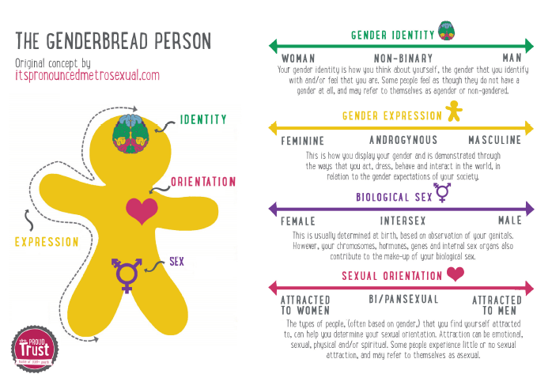
LGBT History Month – Fri 1st Feb 2019
https://lgbthistorymonth.org.uk/#

Slide 22
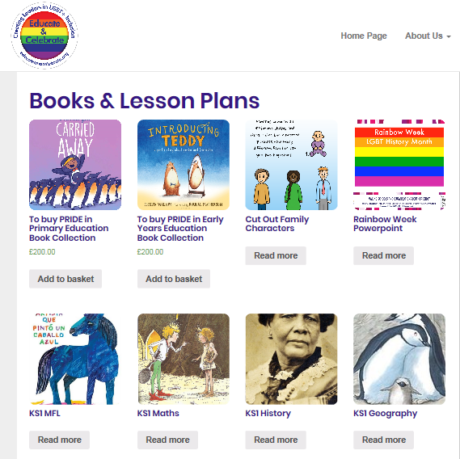
Educate and Celebrate
http://www.educateandcelebrate.org/resources/

Slide 23
Time To Talk Day 7th February 2019
https://www.time-to-change.org.uk/get-involved/timetotalkday2019

Slide 24
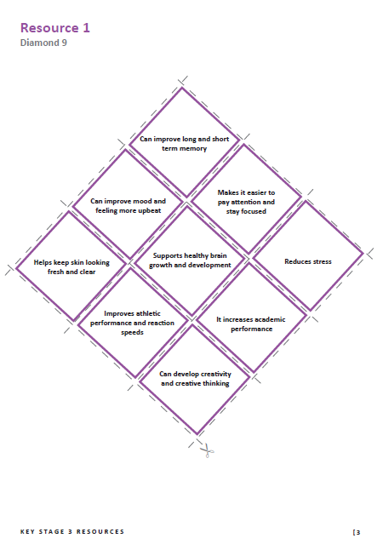
The Sleep Factor Resources, KS2, 3 & 4

Slide 25
School Wellbeing Training
Is Your School Drug Wise? (Primary) - 8th Feb 2019
Gambling & Social Gaming Awareness Education (YGAM) – 5th March 2019
PSHE & Healthy Schools network meeting – 19th March 2019
Effective Leadership & Management of PSHE Education – 27th March 2019

Slide 26
Evaluation

Slide 27
Support :
Steven Body, Healthy Schools & PSHE Consultant (SSE)
07891 273134
steven.body@leeds.gov.uk
Gill Mullens, Healthy Schools Adviser (WNW)
07595 210528
gillian.mullens@leeds.gov.uk
Sheryll Carter, Healthy Schools & PSHE Consultant (ENE)
07891 279418
sheryll.carter@leeds.gov.uk
Emma Newton, Health & Wellbeing Officer
07891 276623
emma.newton@leeds.gov.uk

