Slide 1
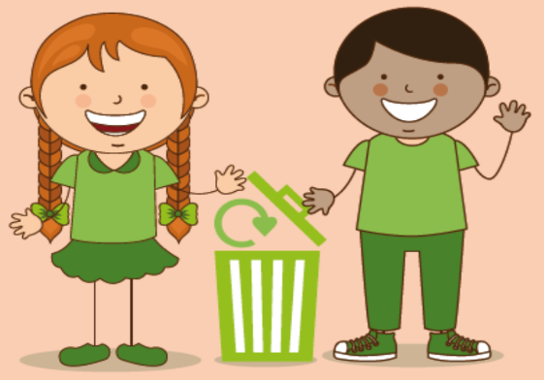
Waste and Recycling
Insert School Name and date
Notes:
Good morning/afternoon.
In today’s assembly we will be looking at ‘Waste and Recycling’ and learning about the importance of looking after the earth’s precious natural resources and helping to prevent damage to our planet and harm to animals.
We will look at how we can all ‘do our bit’ to recycle more through learning about what items go in our household bins and feel how good it is to make a difference.
Okay, hands up if you know what should go in your green bin at home? The main types of materials we put in the green bin are: paper, card, spray cans (deodorants), metal and some plastics. It’s important to recycle as much as we can as this will help protect our environment.

Slide 2

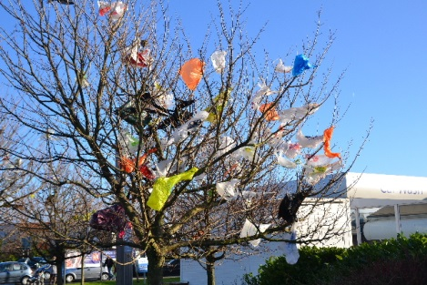

Notes:
Have you ever seen anything like this around here or near to where you live? Who can tell me what is going in this photograph? How does looking at this picture make you feel? You can see that this tree has lots of bits of plastic carrier bags caught up in its branches. These bags have probably been dumped in the street and the wind has blown them into the tree. This doesn’t look pretty, does it? The council will have had to spend money to get a special team and equipment to remove all these bags when that money could have been better spent on other things such as schools, parks or community events. We must make sure that we use the litter bins in the street.
Did anyone see David Attenborough’s TV programme called ‘Blue Planet II’ showing what can happen to wildlife when plastic rubbish ends up in our seas?

Slide 3
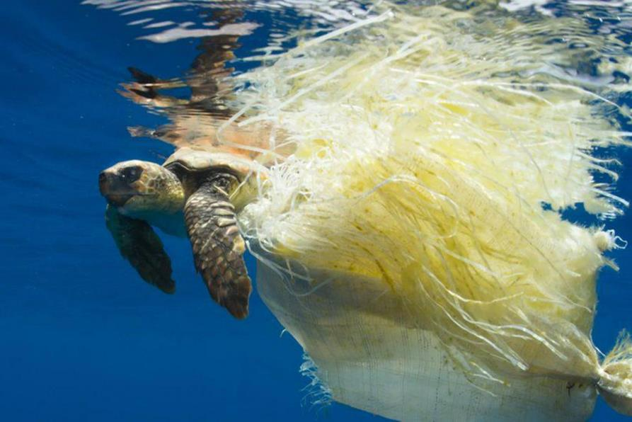
Blue Planet II
Notes:
Rubbish can get anywhere and everywhere; not just in our streets and cities. The rubbish and litter that we don’t keep out of our environment can end up in our seas and oceans damaging the animals and plants living there.

Slide 4
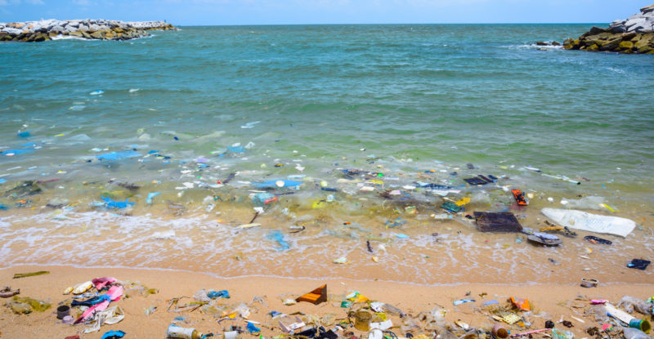
Blue Planet II
Notes:
And if we carry on treating plastic like this, it has been estimated, that by 2050, all the plastic in the sea will weigh more than all the fish in the sea!
So to help us think a little more about our planet, and why it’s important that we look after it and recycle as much as we can, I have a special video to show you.
[PLAY: Astonish Me video]

Slide 5
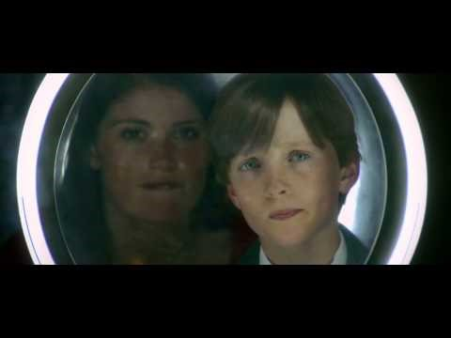
Astonish Me
Notes:
What did you think about that? If I asked you for just one word that comes to mind having seen that film what would it be? Hands up who would like to tell me your word?
I wanted you to see that film because, as well as all the words you said, it reminds me how magical the world is and it tells me that, as clever as we are, we still have lots of new things to learn and discover. We would do well to remember that! Because we are part of a world that we share with lots of other amazing creatures just like Chan’s mega stick, in the film - the longest insect in the world, found in forests in Borneo. At over 50cm long it lives high up in the forest canopy and only three specimens of Chan’s mega stick have ever been found. And what about that incredible barrel-eyed fish - a deep-sea creature with a see-through head and tube-shaped eyes that rotate so that it can see what’s above it in the sea.

Slide 6
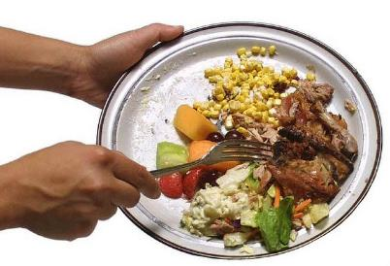
The 4 R’s
Reduce
Recover
Reuse
Recycle
Notes:
Okay, so what do we already know? Has anyone ever seen this triangle before? I want to talk to you about waste and recycling using something called the 4 R’s. Does anyone recognise any of these words? What do you think they might mean?
The best place to be is at the top by trying to Reduce the amount of rubbish that we make in the first place at home and at school e.g. (Click) think about how much food we throw away and try to reduce this by helping our parents planning meals, writing shopping lists and only buying and eating what we need. (Click) Also, we must make sure that we reduce the number of recyclable items we put in our black bins and always put them in the ………. bin [encourage children to call out ‘green’ as the correct colour of the recycling bin in Leeds]
Next Reusing simply means to use again, either by ourselves or by others, things that we no longer have a use for and that someone else might be able to use, such as old toys, furniture, etc. Remember the last time you finished using some of your toys or some of your clothes and didn’t want them anymore, what did you do with them? Did you give them to a charity shop? Who can think of an example of something that can be reused? A ‘bag for life’ can be used over and over again unlike the previous plastic carrier bags - this can help to reduce waste and when they do eventually break they can still go in the green bin to be recycled.
Next comes Recycling, which means making something new out of what we might have thought of as rubbish. We must try to recycle as much as we can and in the right way. There are, of course, some things that can’t go in the green Recycling bin such as glass; but that can be taken to a glass bottle banks across the city.

Slide 7
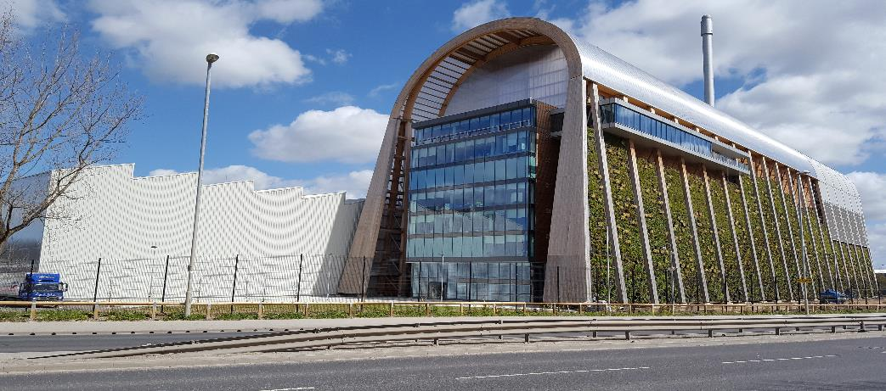
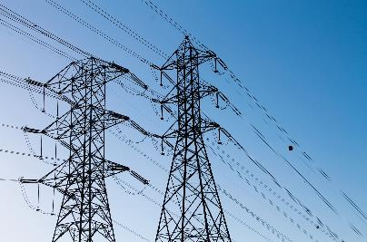
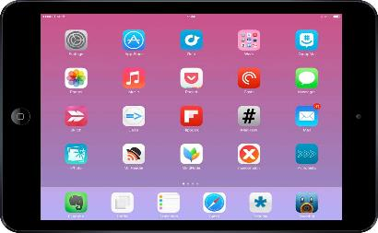


The 4 R’s
Notes:
The final R stands for Recover, which means getting energy out of our waste by burning it to produce electricity (recovering energy from waste). (Click) Has anyone seen this building before? This is the Recycling & Energy Recovery Facility which we call the RERF for short and is where all Leeds’ black bins go to be turned into electricity that powers… (Click)… lights, laptops, phones and other electrical items. It also produces heat and hot water to be used in homes and businesses in and around Leeds. Who wants to go to the RERF? Okay, have you all got your coats?

Slide 8
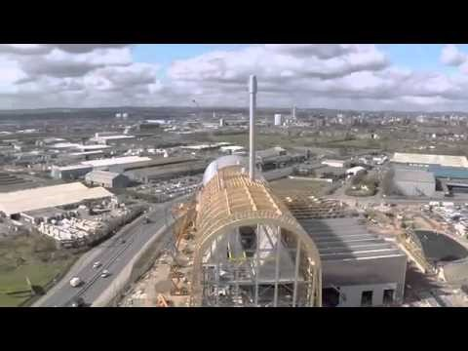
Leeds RERF
Notes:
It’s okay, to save us all a bit of time I have brought the RERF here for you today to have a look at in this film showing how the RERF was built.
[PLAY FILM]
What did you think about that? – it’s a very impressive building isn’t it? So, the rubbish from our black bins now goes there and not to landfill anymore. Do you know what landfill is? [If pupils don’t know explain that landfill is simply a large hole in the ground where we used to put all the rubbish from Leeds’ black bins].
Even though the RERF has clever machines and computers to do some recycling, it can’t do everything for us. It’s important to encourage people to recycle as much as possible at home and at school so that we don’t have to dig up so much new material and cut down as many trees to make new things.

Slide 9

Busta and Pong’s Recycling Song
Notes:
Okay, so we are just going to end the assembly with a special Recycling song that will remind you to remember to keep recycling!

