Slide 1


Are you in control?

Slide 2
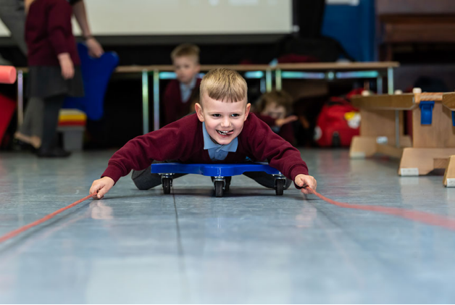
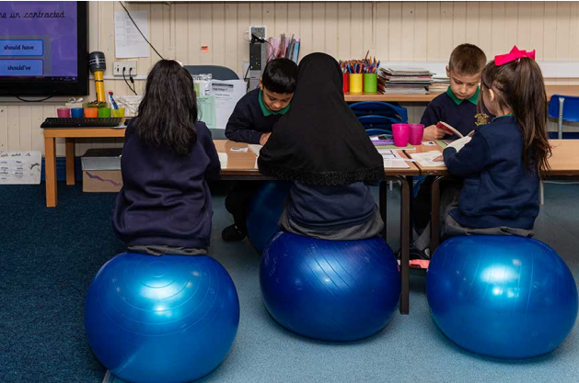
Bang for Your Buck! How can we ensure the effective and sustainable expenditure of the PE & Sport Premium Funding?
Active Schools +
Friday 5 July
11.30 – 12.30

Slide 3
What are the national guidelines and policy linked to the PE and Sport Premium (PESP) and broader PE, physical activity and school sport?

Slide 4
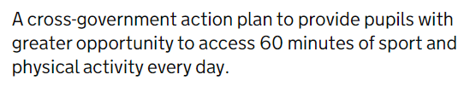

School Sport & Activity Action Plan
High Quality PE and Sport for all pupils
Advocate for 2 hours minimum of PE each week
Primary PE and Sport Premium
Swimming as a key life skill
School Sport and Activity Action Plan (publishing.service.gov.uk)
Extra Curricular Sport and Competition
The School Games
Best use of facilities
NGB support for schools
Opportunity
Equal access to PE & Sport opportunities
- Girls participation in PE and Sport
- Award scheme for equal access
- Participation in PESSPA for SEND pupils

Slide 5
Primary PE & Sport Premium
Funding confirmed until end of 2024/25 academic year
Impact report for 23/24 must be on school websites by July 31 2024 (New template available)
Y6 Swimming assessments against national curriculum targets must be included
New digital reporting to be mandatory by Summer term 2024/25 - ACCOUNTABILITY PRIORITY
No roll over this year!

Slide 6
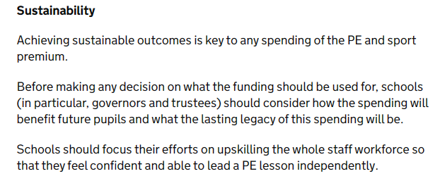

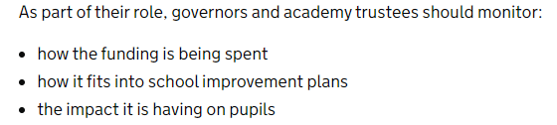
Latest Guidance
PPA Cover via coaches
Large capital expenditure
- MUGAs
- Daily Mile Tracks
- Vehicles
- fixed playground equipment
Curriculum swimming
Staff PE Kit
PE and sport premium for primary schools - GOV.UK (www.gov.uk)

Slide 7
PE & Sport Premium KPIs
1. Increased confidence, knowledge and skills of all staff in teaching PE and sport
2. Engagement of all pupils in regular physical activity
3. The profile of PE and sport is raised across the school as a tool for whole school improvement
4. Broader experience of a range of sports and physical activities offered to all pupils
5. Increased participation in competitive sport

Slide 8
PE and Sport Premium Reporting
The Department has made available for testing purposes, a digital tool for reporting on the PE and sport premium.
The tool is open to all schools on a voluntary basis for reporting on the 23/24 PE and sport premium and information on its use will be used to inform future developments in this area.
The link to the tool can be found here: https://digital-forms.education.gov.uk/lKHg1zq7ka/reporting-pe-and-sport-premium-grant-expenditure.
Guidance on how to complete the tool can also be found here: PE and sport premium funding 2023 to 2024 reporting and assurance - GOV.UK (www.gov.uk)

Slide 9


What challenges are you experiencing in relation to the PESP?

Slide 10
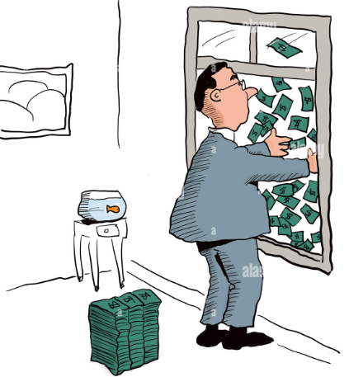


It’s a double edged sword!

Slide 11



Active Quiz

Slide 12
Approx. how much PESP have schools received since 2013?
A
200+
150k+
100+

Slide 13
How many minutes are schools responsible for?
A
60
30
20

Slide 14
What % of children in England are meeting the CMO guidelines of 60 mins?
A
62%
47%
20%

Slide 15
What is the largest amount of underspend I have come across in a single school?
A
40k
20k
30k

Slide 16
What is the worst example of expenditure I have seen ?
Coach
Salary 18k
Fix heating 15k
Unused DM track 10k

Slide 17
How do we solve a problem like the PE & Sport Premium?
End of the year surplus leading to poor, short term decision making
Large capital expenditures
Undermining of PE leads – “I’ve no idea where it goes!”
Funding of wider school staff
Over spending in one KPI area
Keeping to the status quo
Unsustainable interventions

Slide 18
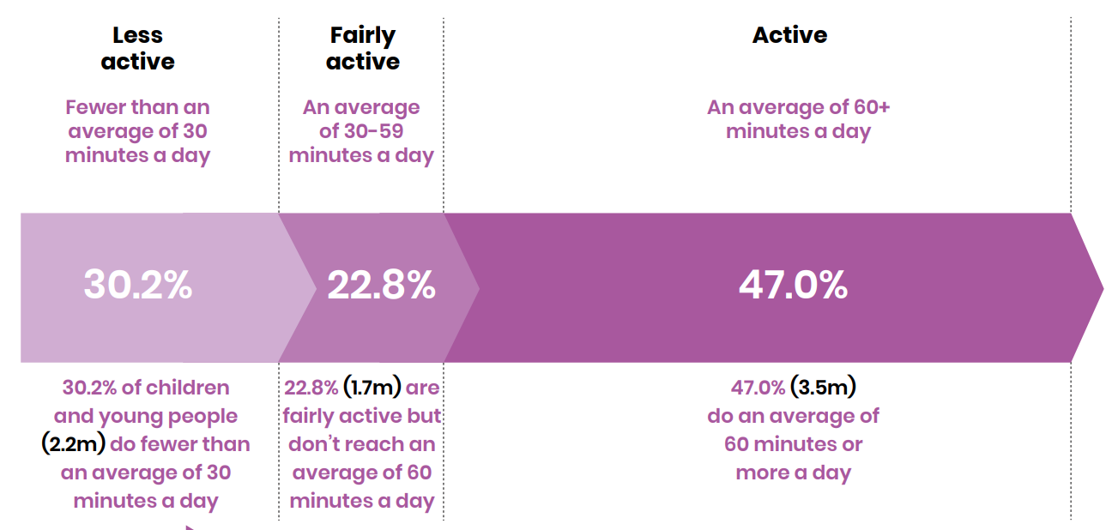
CYP Active Lives

Slide 19
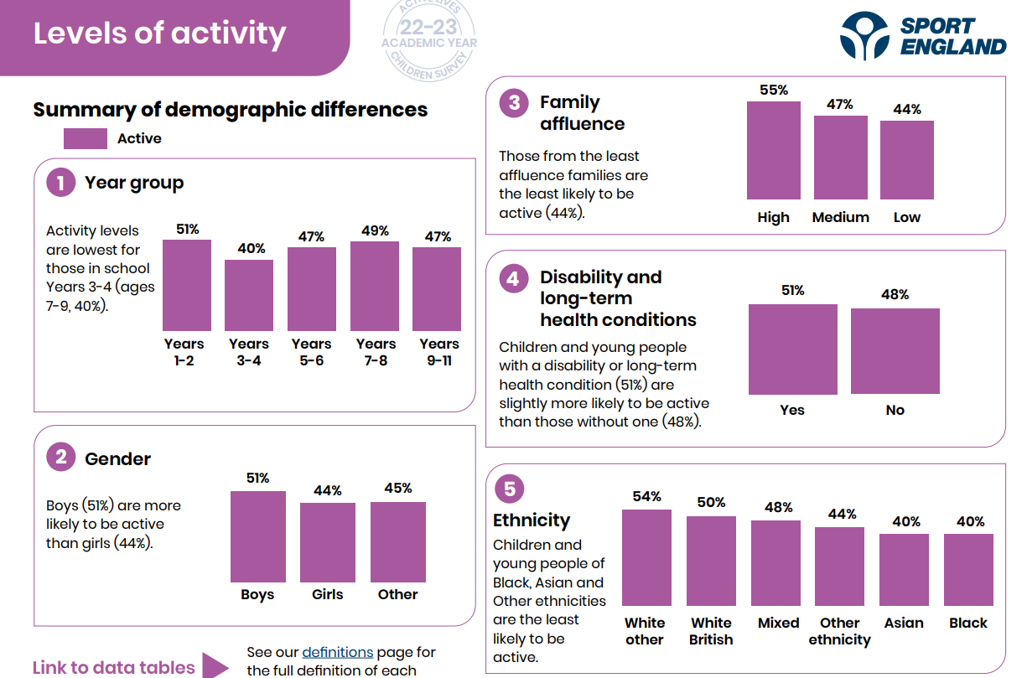

Slide 20
Systems around children’s needs
NOT policy outcomes
Minutes of Moderate-to-
vigorous
PA
byproduct
Fundamental
Movement Skills
Fitness
Cognitive
challenge
Socialisation
Motivation
Passion
Fun

Slide 21

The Sticky Plaster Approach

Slide 22
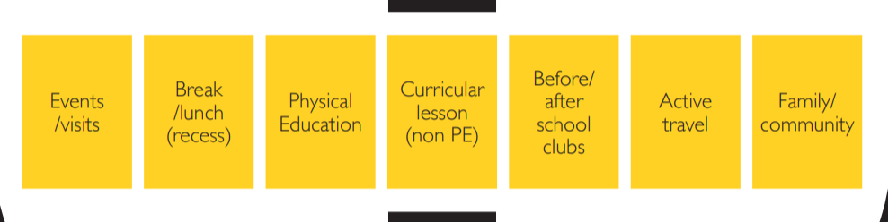
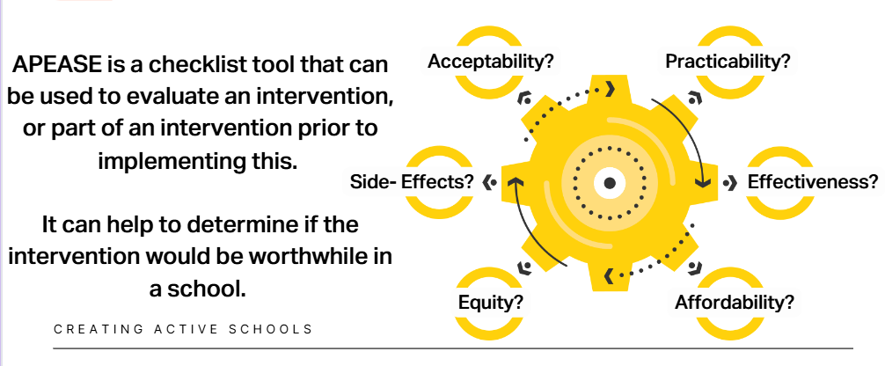
APEASE

Slide 23
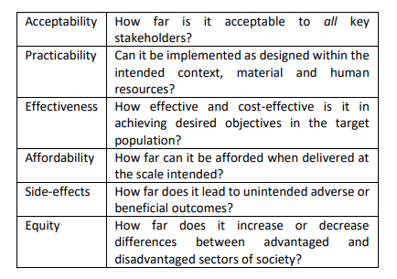

Slide 24


Putting the conditions of the grant to one side…..
Give a score of strength out of 10 for each category
Daily Mile
Track

Slide 25
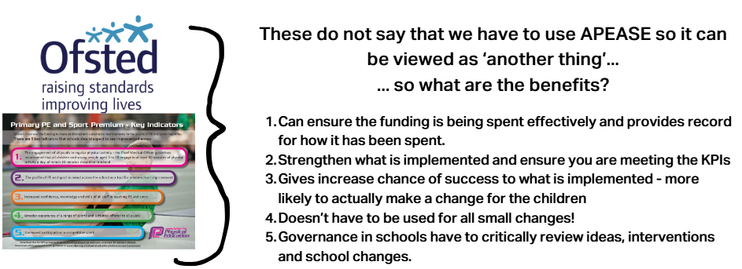
APEASE

Slide 26
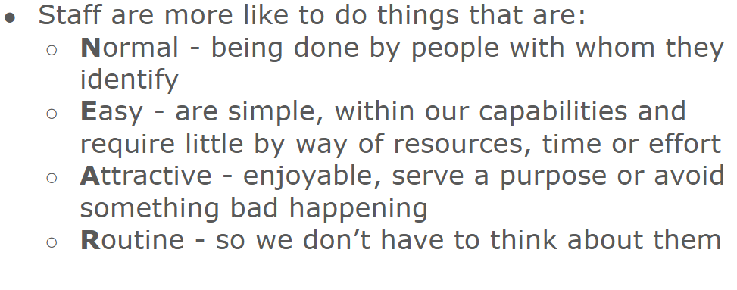
Reflect and Consider

Slide 27
How can PESP expenditure be aligned with and support whole school improvement priorities?

Slide 28
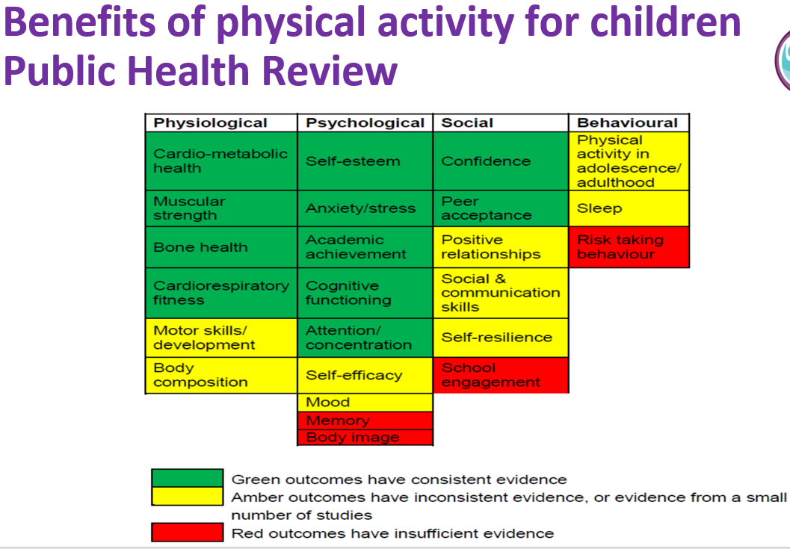
During the 2021/22 academic year, while wellbeing on most measures remained consistent, anxiousness among both primary and secondary-age pupils appears to have increased and is higher than in 2020/21 (DfE, State of the Nation: CYP report 2022).

Slide 29
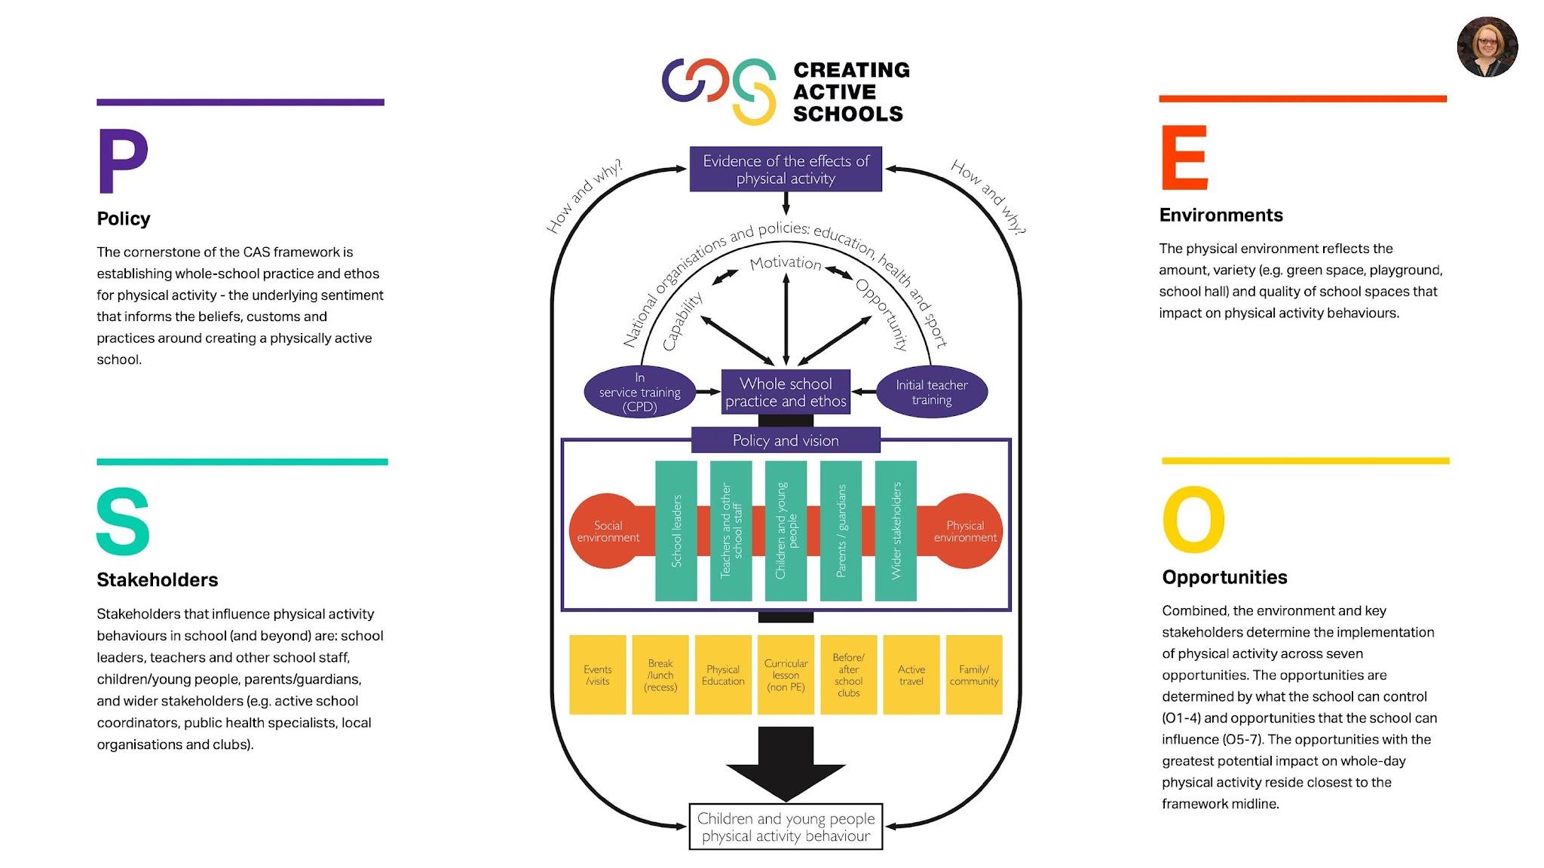
Systems around children’s NEEDS
NOT policy outcomes
Minutes of Moderate-to-
vigorous
PA
byproduct
Fundamental
Movement Skills
Fitness
Cognitive
challenge
Socialisation
Motivation
Passion
Fun

Slide 30
What do low cost/high impact solutions look like fuelled by the PE & Sport Premium?

Slide 31

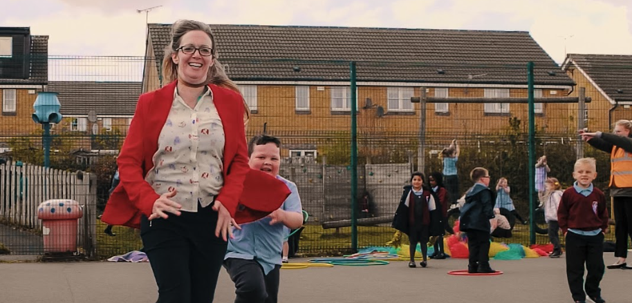
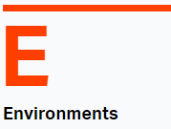


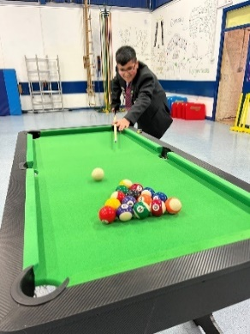
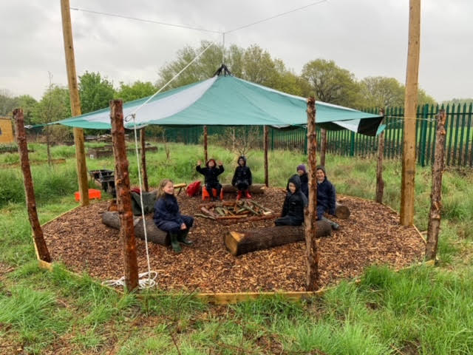
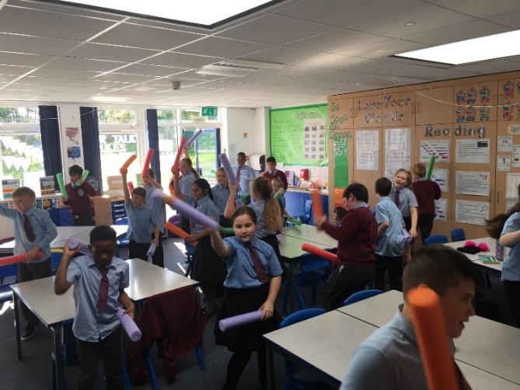
Active Enrichment
Protected 1 hour of PA every Friday proceeded
by memory & retrieval work (Policy & Routines)
Standing agenda item in governor T & L
meetings (School Improvement)
Written into SDP & linked to 4 OFSTED areas
(School Improvement)
Key part of new physical activity policy
(Policy & Routines)
Influencing behaviour policy ensuring pupils are
engaged through rich and fun experiences
(Policy & Routines)
Timetabling Active Enrichment sessions during
curriculum time for SEMH pupils (Policy & Routines)
Footage shared on social media EVERY Friday (Communications)
Number of behaviour incidents reduced during curriculum time
Pupils attainment increased (2022 data)
Good with outstanding leadership (OFSTED 2022)
PA is now impacting on the holistic development of pupils due to more varied opportunities
Shift to pupils and staff understanding how movement can enhance learning outcomes and academic performance
EYFS – increased competency/ gross motor development.

Slide 32

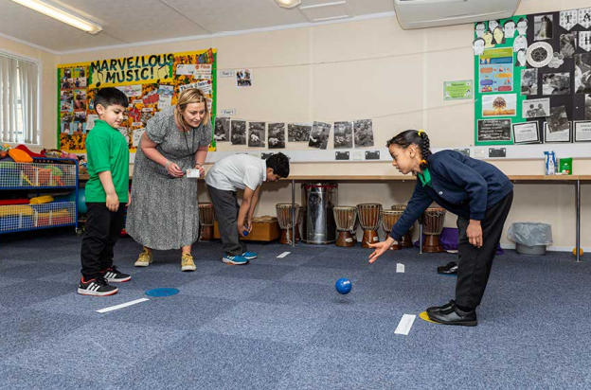
SLT expectation that staff specifically plan for active learning opportunities across the curriculum
Built into performance management/SIP
Regular and supportive year group observations by SLT
Declutter classroom spaces
Placed resources which children must move to collect
Exercise balls in each class
Active Learning displays
Regular PAL staff CPD and meetings to share learning
Year group meetings and feedback
AFL - Different body moves to communicate to the teacher
Answering questions in an active way
Pupils working on the floor or writing on walls
Drip fed active learning tasks into curriculum lessons

Slide 33
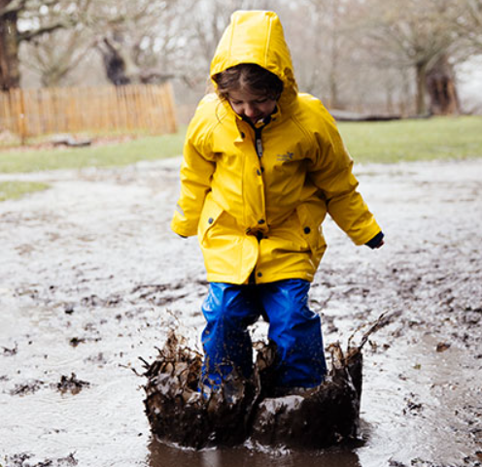
What low cost/high impact solutions have you embedded?
Consider APEASE in your conversations
Building PAL into performance management and setting whole school targets around physical activity.

Slide 34
“During inspections, Ofsted assess how effectively leaders use the Primary PE and Sport Premium and measure its impact on outcomes for pupils, and how effectively governors hold them to account for this.”

Slide 36
Termly meetings and checkpoints
Autumn term:
Discuss plans for allocation of funding for the coming year - how do proposed plans align with the school development plan? How have they been informed by both pupils and staff? Is there coverage across KPIs? Check and challenge – do any plans go against the DfE guidance e.g. swimming, PPA, capital? Are they sustainable? Establish your role in deciding how the premium is to be spent and how you will work with senior leaders to review and plan for this? Does your school website have an up to date report on the previous academic year’s premium? Spring Term: Meet with key staff to understand and review progress and impact against planned targets and outcomes Is expenditure on track? Do you need to shift the focus elsewhere to avoid unused spend? Summer Term: Meet with key staff to understand and review progress and impact against planned targets and outcomes. Discuss plans for the next academic year in line with whole school priorities Support reporting of the spend using the correct documentation

Slide 37
Further resources
School sport and activity action plan - GOV.UK (www.gov.uk)
PE and sport premium for primary schools - GOV.UK (www.gov.uk)
Physical Literacy Consensus Statement for England published | Sport England
afPE Publications & Resources - Association for Physical Education - Association For Physical Education | P.E.
Advice on Primary PE and Sport Premium - Association for Physical Education - Association For Physical Education | P.E. (afpe.org.uk)
Primary PE & Sport Premium - Youth Sport Trust
Recommended Guidance for Coaches on the Standards for Deployment - UK Coaching

