Slide 1
School Food Leadership Forum
The Health and Wellbeing Service
Notes:
Welcome delegates and introduce the training session.
Ensure all delegates have signed in for attendance records and made a name badge.

Slide 2
Welcome and housekeeping
Zoom functions
Cameras and microphones
Questions
Minutes and documents

Slide 3
Introductions:
Siobhan Jennings - Healthy Eating Advisor & Nutritionist
Email: Siobhan.Jennings@leeds.gov.uk
Health and Wellbeing Service, Children and Families, Leeds City Council
Karen Clay - Business Development Office

Slide 4
Aims of the forum
To provide an opportunity for school leaders to come together and share ideas and successes around nutrition and school food.
To share key information, local and national DfE updates.
To listen to your concerns and challenges and shape our support offer to meet your needs.
To consider our next steps for school food.

Slide 5
Agenda
Impact of the pandemic on children’s eating and school food
Key local and national updates on school food
  Free school meals
  Winter Grant
  Healthy Holidays
  Food Clubs & digital food map
Current challenges and successes
Leadership responsibilities for food in school
Next steps and opportunities
Further resources and training
AOB

Slide 6
Impact of COVID-19 on children’s eating and food
The number of FSM awards in March 2020 was 25,874
Current number of FSM awards is at 30,740, which includes 177 Asylum Seekers.
A survey on behalf of the charity the Food Foundation found that food insecurity in households with children had nearly doubled since the start of the pandemic, not including food insecurity that was due solely to supply issues.
Notes:
There was been an accelerated increase in the number of FSM claims since COVID-19.

Slide 7
Impact of COVID-19 on children’s eating and food
Concerns are now growing that the covid-19 pandemic has exacerbated nutritional problems associated with food insecurity.
These include obesity, undernourishment, nutrient deficiencies, and mental health problems such as anxiety, low self-worth, and depression.
Many families on low income have relied on school food throughout the pandemic.
Parents who were working and caring for children may also have struggled to plan and prepare balanced meals.
Notes:
As the government pushes its obesity strategy to “beat coronavirus,” experts are concerned that the pandemic has tipped many more families into food poverty—with particular concerns for children’s physical and mental health.

Slide 8
Prevalence of obesity from 2008/09 to 2019/20 by school year compared regionally and nationally

Slide 9
Prevalence of obesity in Year 6 aggregated from 2015/16 to 2019/20 by school cluster

Slide 10
Impact of COVID-19 on children’s eating and food
Group discussion

Slide 11
Key local and national updates on school food
Providing school meals during the coronavirus (COVID-19) outbreak - GOV.UK (www.gov.uk)
https://www.gov.uk/government/publications/covid-19-free-school-meals-guidance/covid-19-free-school-meals-guidance-for-schools#claiming-additional-costs

Slide 12
Claiming additional costs links to school meals and COVID-19
The deadline for claiming is 4th May
You can claim:
  up to £3.50 per pupil eligible for benefits related free school meals, per week, where lunch parcels have been provided during the period 4 January 2021 until the start the Easter holidays.
  up to £15 per pupil eligible for free school meals pupil, per week, where vouchers for local shops or supermarkets have been provided
For the period 4 January 2021 up to the start of the Easter holidays
Coronavirus (COVID-19) free school meals additional costs: guidance - GOV.UK (www.gov.uk)

Slide 13
Free school meals during term time
Where pupils eligible for benefits related free school meals are self-isolating at home, schools should work with their school catering team or food provider to provide good quality lunch parcels.
This only applies to pupils eligible for means tested FSM, not universal infant free school meals (UIFSM).
Under normal circumstances or for absences in relation to other reasons, schools are not expected to provide food parcels.
Where parents are unable to collect the parcel, they can tell the school that they have asked a friend, volunteer or family member to collect it on their behalf.
There is no mention by the DfE of using vouchers to support isolation pupils at present.

Slide 14
COVID Winter Grant - Update
On the 8th November, 2020, the government announced a £170 million COVID Winter Grant Scheme (CWGS).
The CWGS allocated just over £2.8million to Leeds City Council to support those most in need with the cost of food, energy (heating, cooking and lighting), water bills (including sewerage) and other essentials
£1.6 million of the funding was approved to be allocated to for the provision of FSM to children living in poverty in the city for the Christmas 2020 and February 2021 half-term holidays.

Slide 15
COVID Local Support Grant - Update
Additional funding was awarded to extend the scheme over Easter and this has now been confirmed to also cover the May half term.
School can opt for hampers (with Catering Leeds, private catering provider, Morrison's) or vouchers.
You school will receive an email asking you to confirm your numbers for FSM and those with NRPC, plus up to 10% extra of your entitlement for other vulnerable pupils.
Queries relating to the Winter Grant - send to thriving@leeds.gov.uk

Slide 16
Healthy Holidays – Summer 2021
The programme for this summer is being expanded and schools in all areas of the city will be apply to apply for funding to deliver schemes.
The funding provided is to support children in receipt of means-tested FSM across the city - not a replacement for free school meals.
Focus is on healthy food and activity - not vouchers
Contact for Healthy Holidays is Amelia.Gunn@leeds.gov.uk
Expression of interest form is available
Food Standards will also be available
Notes:
Summer schools scheme – colleagues , Amelia are talking to the DfE to see how it may fit in

Slide 17
Food Clubs
Family Action FOOD Clubs are in operation across the country. In Leeds there will be 12 FOOD Club venues in operation.
Aim is to provide families with good-quality food at a low cost, while also reducing food waste.
It costs £1 a year to become a member.
Once joined, a family can purchase a bag of tasty food items every week worth approx. £15 for just £3.50
The FOOD Clubs are self-referral so are open to all members.
Ideally members would be within 15 minutes walking distance of the FOOD Club, although this is not strictly enforced.

Slide 18
Food Clubs https://www.family-action.org.uk/what-we-do/children-families/food-club/
Henry Barran Centre (Family Action) | Friday 26th February 12pm-2pm | Mondays 9.30-11.30am, Fridays 12-2pm
Gipton South Children’s Centre | Tuesday 16th March 10am-12pm | Tuesdays 10-12pm Thursdays 1.30-3.30pm
Parklands Children’s Centre | Wednesday 17th March 11am-1pm | Wednesdays and Fridays 11am-1pm
Richmond Hill Academy Children’s Centre | Friday 19th March 2.30-4.30pm | Mondays 8.45am-10.45am Fridays 2.30-4.30pm
Barca (Broadleas Community Centre) | Thursday 25th March: 12pm-2pm | Tuesdays 12.00-2pm Thursdays 12.00-2pm
Armley Chapel Lane Children’s Centre | Thursday 25th March: 11am-1pm | Initially Thursday 11-1pm
Nowell Mount Children’s Centre | Friday 26th March 9.30-11.30am | Monday 1-3pm Friday 9.30-11.30am
Dewsbury Road Children’s Centre | Tuesday 30th March 9.30-11.30am | Tuesdays 9.30-11.30am and Thursdays 1.30-3.30pm
Middleton Play and Learning Children’s Centre | Wednesday 14th April 1-3pm | Mondays 9-11am, Wednesdays 1-3pm
Notes:
St Philip’s Church in Osmandthorpe w/c 17th May, then Bramley Community Centre on 22nd May and Middleton CC around the beginning of June.

Slide 19
Leeds Food Provision Map
Leeds Food Aid Network, Leeds City Council and partners have been working together to map food provision.
Shows where projects and services are based in Leeds and provides further information including eligibility and how to refer.
Please note - the information on the map will be reviewed and the best ways to seek permission and make this publically available will be considered shortly.
The aim of the map is to help partners to:
  support signposting
  understand the provision in the city
  identify strengths and gaps in provision
Notes:
Food provision in the city has changed dramatically since the start of the Coronavirus pandemic. Existing projects have experienced differing demands - more commonly increases, new projects have emerged, some projects have changed the way in which they operate to continue support throughout the various restrictions and food businesses have offered support.

Slide 20
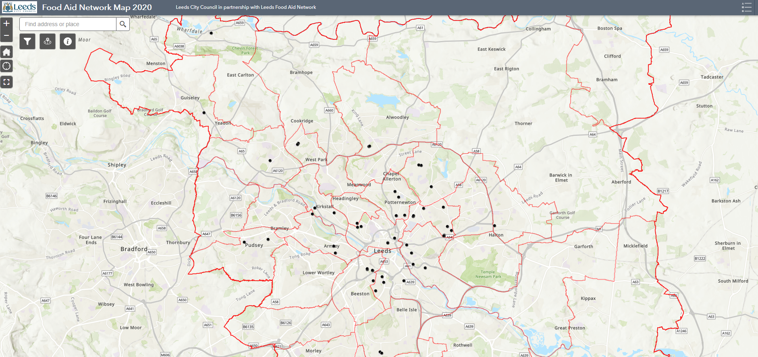
Leeds Food Provision Map
This map is available at: https://leedsfoodaidnetwork.co.uk/document-2/ and is password protected to secure use of the map for frontline staff only and not the public directly at this stage. Please use the password: FoodAidNetwork21 to access.

Slide 21
Current challenges and successes for food in school
Break out rooms – up to 10 minutes

Slide 22
Statutory and leadership responsibilities for school food

Slide 23
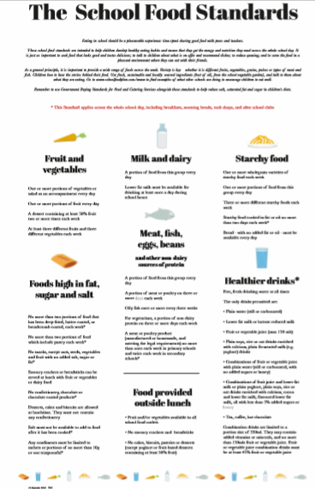
School Food Standards
All food served in school should meet the School Food Standards.
Breakfast, break, lunch and after school up to 6pm.
Occasional celebrations, fundraising or special events are excluded.
Responsibility of meeting these sits with the Governing Body.
For support with menus or compliance contact schoolwellbeing@leeds.gov.uk

Slide 24
Food allergies
Schools should make sure that they identify pupils with any medical conditions, including allergies, to ensure that all pupils are able to eat a school lunch safely.
This is particularly important in circumstances where caterers are not serving meals to pupils directly but where for example, pupils are being served food in the classroom.
The Food Information Regulations 2014 require all food businesses including school caterers to show the allergen ingredients’ information for the food they serve. This makes it easier for schools to identify the food that pupils with allergies can and cannot eat. Further information is available in allergy guidance for schools.
Work with your catering provider for advice and support with this.
Also consider allergies as part of an inclusive cooking curriculum.

Slide 25
Food in the curriculum
D&T, Health Education, Science (statuary), PHSE, whole school approach

Slide 26
Design and Technology - Cooking and Nutrition
Key stage 1 Pupils should be taught to: | Key stage 2 Pupils should be taught to: | Key stage 3 Pupils should be taught to:
use the basic principles of a healthy and varied diet to prepare dishes. | understand and apply the basic principles of a healthy and varied diet. | understand and apply the principles of nutrition and health.
 | prepare and cook a variety of predominantly savoury dishes using a range of cooking techniques. | cook a repertoire of predominantly savoury dishes so that they are able to feed themselves and others a healthy and varied diet. become competent in a range of cooking techniques
understand where food comes from. | understand seasonality, and know where and how a variety of ingredients are grown, reared, caught and processed. | understand the source, seasonality and characteristics of a broad range of ingredients.

Slide 27
Health Education – Healthy Eating
(Primary Curriculum)
Pupils should know:
what constitutes a healthy diet (including understanding calories and other nutritional content);
the principles of planning and preparing a range of healthy meals; and
the characteristics of a poor diet and risks associated with unhealthy eating (including, for example, obesity and tooth decay) and other behaviours (e.g. the impact of alcohol on diet or health).
Module 3
Notes:
Here are some ideas you may have thought about.

Slide 28
Health Education – Healthy eating (Secondary Curriculum)
Pupils should know:
How to maintain healthy eating and the links between a poor diet and health risks, including tooth decay and cancer.
Module 3
Notes:
Here are some ideas you may have thought about.

Slide 29
Whole school food policy
Sets a framework for all food related activities in school, ensuring that aims and outcomes are consistent with and supportive of the overall goal of improving health and wellbeing.
School leaders should be actively involved in developing and reviewing your food policy
Cover food provided by school, food brought in from home, food in the curriculum and all other aspects of food culture and ethos (e.g. birthdays, waste, growing etc.)

Slide 30
Next steps for food in school
Group discussion

Slide 31
Next steps for school food
Transition back into dining rooms – reception / Year 7
Get the menu right – work with your catering provider
Promote your school meals service
  Newsletters
  Taster sessions
  Virtual tour or your dining room/eating areas
  Photos of school food
  Consider target year groups/groups of pupils e.g. Year 2, FSM
Review school food and packed lunch policies ready for the next academic year

Slide 32
HENRY – Healthy Families Growing up
A holistic new lifestyle programme to support a healthy weight in primary age children.
8 week course for parents
Healthy lifestyles, balanced meals, portion sizes, body image, being active, sleep, parenting, meal times, behaviours and more.
Coming soon …
Contact schoolwellbeing@leeds.gov.uk to arrange a course at your school

Slide 33
Healthy Eating: Training and events
Virtual: Growing Food and Climate Change - 29th April 2021
Learn how to grow in the classroom and re-start your school garden ready for summer.
https://www.leedsforlearning.co.uk/Event/120825
Virtual: Breakfast and After School Club Training - 5th May 2021
Ensure your breakfast and after school clubs are compliant with the School Food Standards and meeting the needs of your pupils.
https://www.leedsforlearning.co.uk/Event/135636
Virtual: Primary and Secondary Cooking & Nutrition Conference - 7th July 2021
Bringing food education to life in partnership with the British Nutrition Foundation (BNF). A virtual event with a hands on cooking experience for both primary and secondary schools.
https://www.leedsforlearning.co.uk/Event/126771

Slide 34
Family Food Leaflet
https://www.schoolwellbeing.co.uk/resources/653

Slide 35
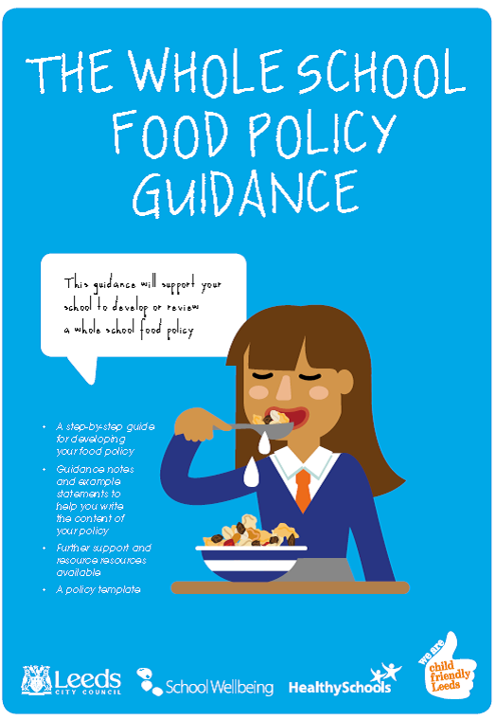



Toolkits to support food in schools
https://www.leedsforlearning.co.uk/Store or email schoolwellbeing@leeds.gov.uk

Slide 36
HENRY – Healthy Families Growing up
A holistic new lifestyle programme to support a healthy weight in primary age children.
8 week course for parents
Healthy lifestyles, balanced meals, portion sizes, body image, being active, sleep, parenting, meal times, behaviours and more.
Coming soon …
Contact schoolwellbeing@leeds.gov.uk to arrange a course at your school

Slide 37



















Pledge for a Healthy and Active Future
Aim of the pledge
To support schools to consider and shape the school environment (and surrounding area) to make it easier for pupils, teachers and community members to eat well and be physically active
Notes:
BB

Slide 38
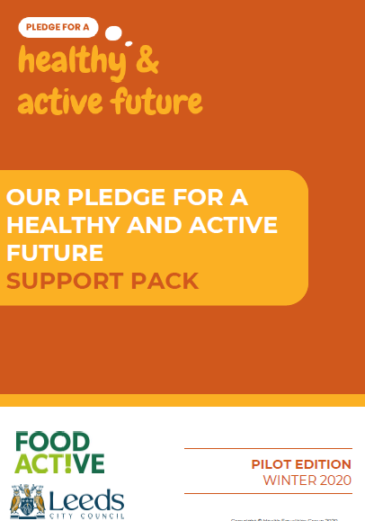
PHAF Support Pack
The support pack provides a brief overview of the Local Authority Declaration on Healthy Weight and an introduction to the associated Pledge for a Healthy and Active Future including information on how this can be implemented, communication resources and guidance on monitoring and evaluation.
Email: Siobhan.Jennings@leeds.gov.uk to find out more or access the resources.
Notes:
BB

Slide 39
Catering Leeds – Food waste project
Catering Leeds are looking for school who would like to look at reducing food waste
To help address climate change
Contact schoolwellbeing@leeds.gov.uk or your Catering Leeds Business Builder directly

Slide 40

Healthy Eating Week
British Nutrition Foundation, Food a Fact of Life
14th - 18th June 2021
Register for free resources for your school
BNF Healthy Eating Week 2021 (office.com)

Slide 41
Any further, questions, comments, concerns or any other business?
Email: Siobhan.Jennings@leeds.gov.uk www.schoolwellbeing.co.uk
  www.healthyschools.org.uk
  www.leedsforlearning.co.uk
Twitter: @healthyschools_ @schoolwellbeing

